Slide 1
Outline
Quantum optimization
Quantum machine learning
Quantum simulation

Slide 2
1. Quantum optimization
1.1. Parameterized quantum circuit (PQC)
1.2. Circuit ansatz
1.3. Compilation
1.4. Gradient and optimizer
1.5. Encoding
1.6. Quantum optimization
1.7. Additional informations

Slide 3
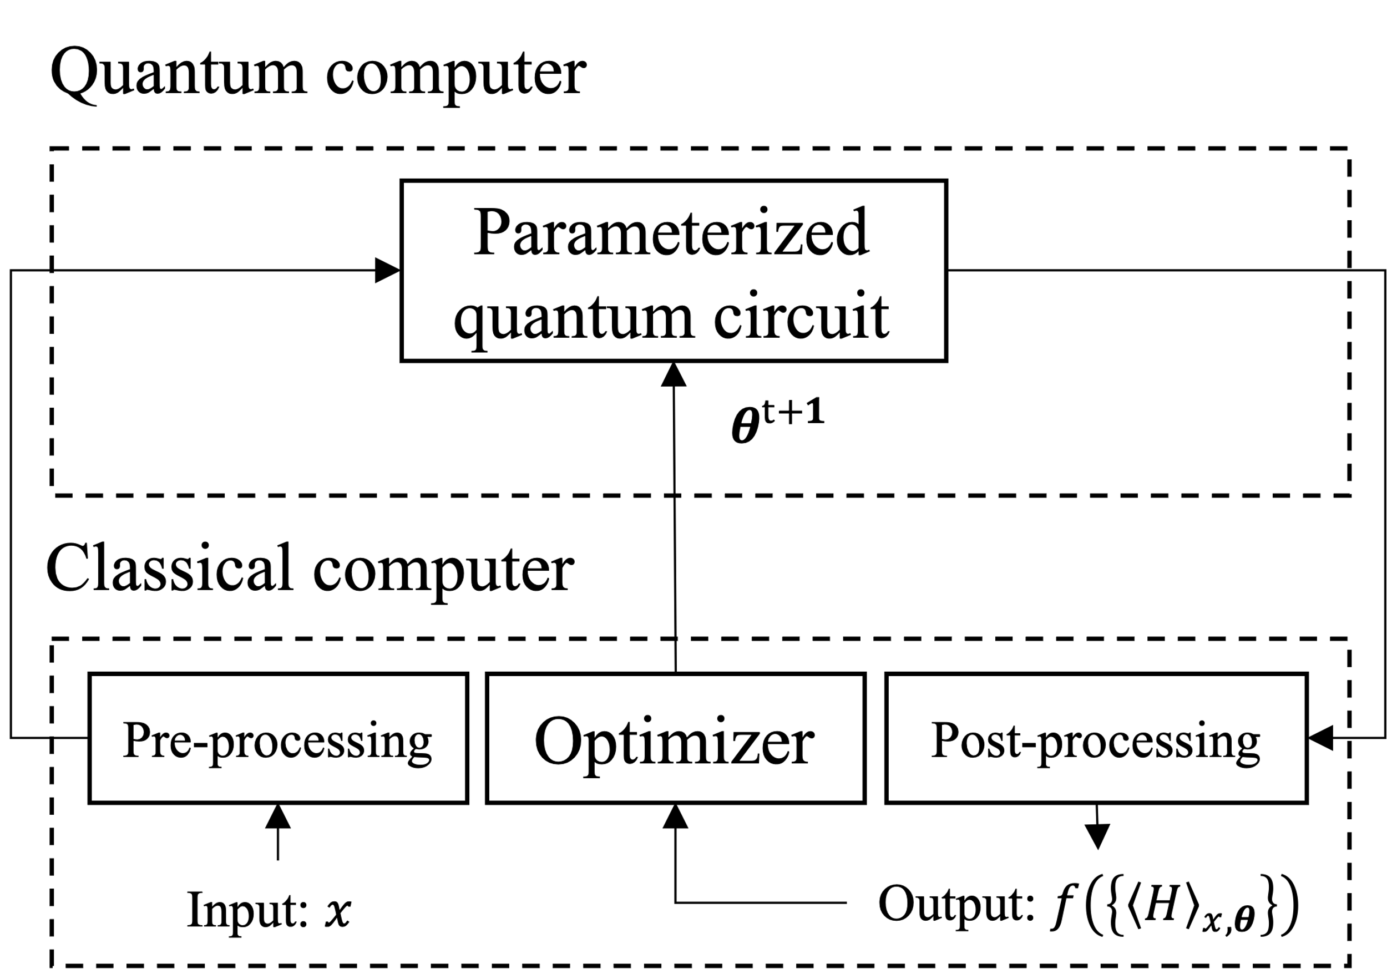
1. Quantum optimization Hybrid quantum - classical model
Hybrid model [1.1]
[1.1] M. Schuld and F. Petruccione, Machine learning with quantum computers (Springer, 2021)
Notes:
Mô tả tổng quát của hệ hybrid quantum - classical được sử dụng trong các thuật toán QML. Trong hệ, máy tính lượng tử chuẩn bị các trạng thái (quantum state preparation) và thực hiện phép đo. Máy tính cổ điển sử dụng các kết quả đo để hậu xử lý, và cập nhật parameter 𝜽 cho PQC. Quy trình này được lặp nhiều lần.

Slide 4






1.1. Parameterized quantum circuit (PQC)
(Main) qubits
$${\left|0\right\rangle }^{⊗m}$$
$$R_{Y}\left(θ_{0}\right)$$
Ancilla qubits
$$U\left(θ\right)$$
$$R_{X}\left(θ_{2}\right)$$
$$V\left(θ_{4−7}\right)$$
$${\left|0\right\rangle }^{⊗n}$$
$$R_{X}\left(θ_{1}\right)$$
$$R_{Z}\left(θ_{3}\right)$$
Trainable parameter
Classical channel
$$c$$
1-qubit gates
2-qubit gates
multi-control gate
complex gate
$θ={\left[\begin{matrix}θ_{0} & θ_{1} & …\end{matrix}\right]}^{⊺}$
[1.2] Benedetti, M et al, Parameterized quantum circuits as machine learning models. Quantum Science and Technology, 4(4), 043001 (2019)
Gate $R_{i}(θ)$ rotate state $θ^{o}$ about the $i$-axis where $i∈\left\{X,Y,Z\right\}$ and $θ∈[0,2π]$
Notes:
Vector đầu vào được ánh xạ sang không gian Hilbert $φ(x)$ bằng Encoder $U_{φ}$.
Circuit $U(θ)$ tác động và trả về $U\left(θ\right)Uφ\left(x\right){\left|0\right\rangle }^{⊗\left(n+m\right)}$.
Tập các observable $\{M_{i}\}$ hỗ trợ thao tác đo, ánh xạ trạng thái lượng tử tới không gian output thông qua hàm $f$.

Slide 5
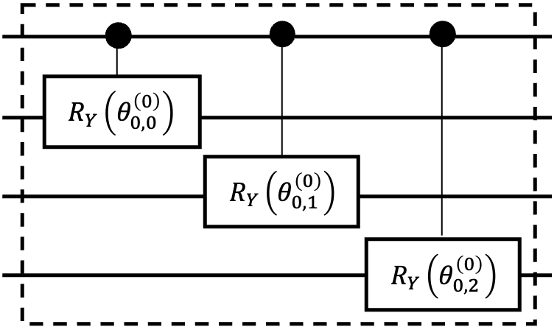
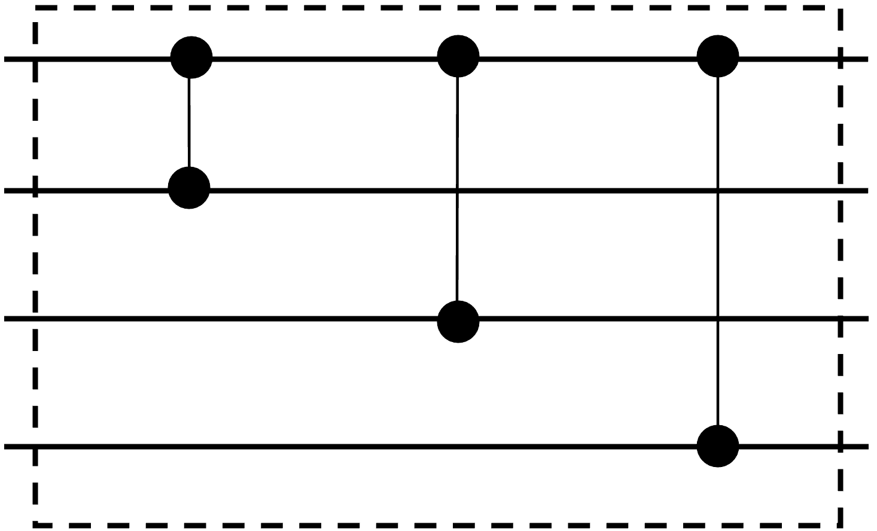



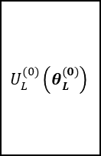


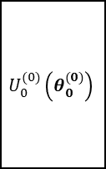




1.2. Circuit ansatz Structures
Layer $ℓ$
Layer 1
Layer 0
…
$$U^{(1)}\left(θ^{(1)}\right)$$
$$U^{(0)}\left(θ^{(0)}\right)$$
Example $U_{k}^{(j)}\left(.\right)$: Graph – star [16]
$$U_{0}^{(0)}\left(θ_{0}^{(0)}\right)$$
$$V_{0}^{(0)}$$
$$U_{L}^{(0)}\left(θ_{L}^{(0)}\right)$$
$$V_{L}^{(0)}$$
$$…$$
$CZ$ gate
Example $V_{k}^{(j)}$: Control – Z [16]
Fixed sub-layer
[1.3] Haug, T et al, Capacity and quantum geometry of parametrized quantum circuits. PRX Quantum, 2(4), 040309. (2021)
[1.4] https://pennylane.ai/qml/glossary/circuit_ansatz
Parameterized sub-layer
Notes:
Cấu trúc của U, có thể chia thành các lớp con chứa tham số và ko chứa tham số.

Slide 6
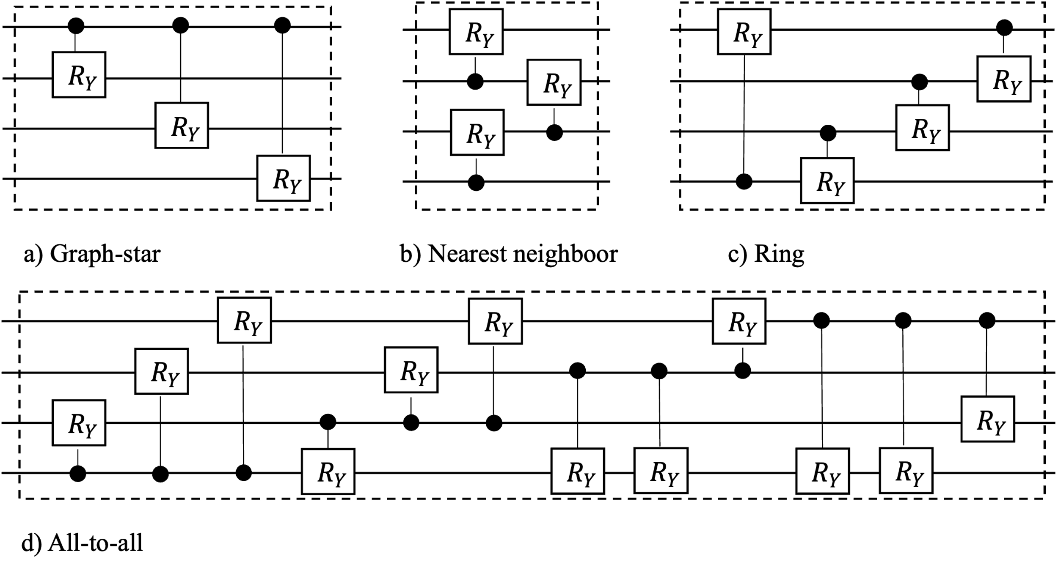





























1.2. Circuit ansatz Existing ansatzes
All-to-all
$$R_{Y}$$
$$R_{Y}$$
$$R_{Y}$$
$$R_{Y}$$
$$R_{Y}$$
$$R_{Y}$$
Odd layer
Even layer
$${g) W}_{all−to−all}$$
Graph-star & Nearest Neighboor
$$R_{Y}$$
$$W_{i}$$
$$R_{X}$$
$$R_{Z}$$
$$R_{Y}$$
$$R_{X}$$
$$R_{Z}$$
$$R_{Y}$$
$$R_{Y}$$
$$R_{X}$$
$$R_{Z}$$
$${f) W}_{alternating}$$
$$R_{X}$$
$$R_{Z}$$
$$R_{Y}$$
Ring
$$R_{Y}$$
$L$ layer
$$R_{Y}$$
$R_{i}\left(.\right)$
Control $R_{i}$ gate
[1.5] Haug, T et al, Capacity and quantum geometry of parametrized quantum circuits. PRX Quantum, 2(4), 040309. (2021)
$$e) W_{chain}$$
$R_{i}\left(.\right)$
$R_{i}$ gate
Notes:
Các cấu trúc graph – based, ring, nearest neighboor, all-to-all. Biến đổi một chút => các cấu trúc W

Slide 7
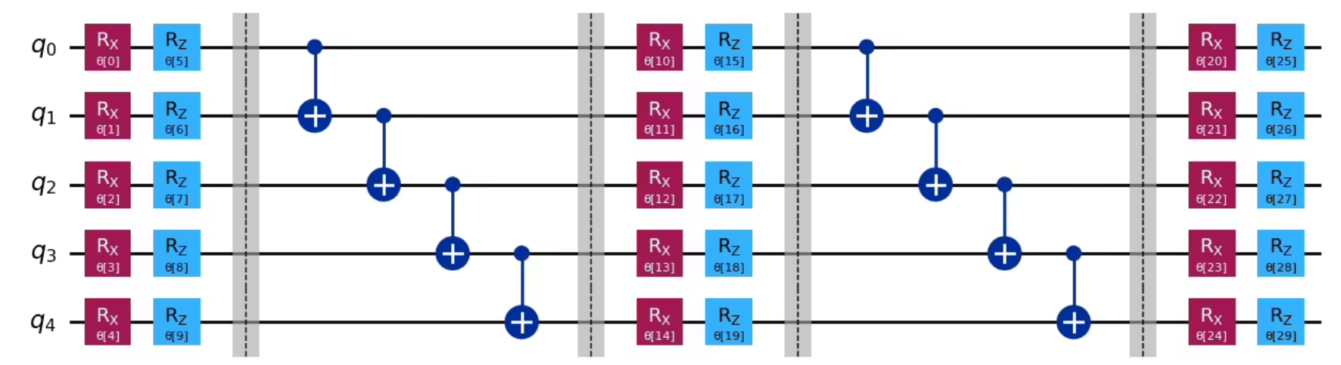
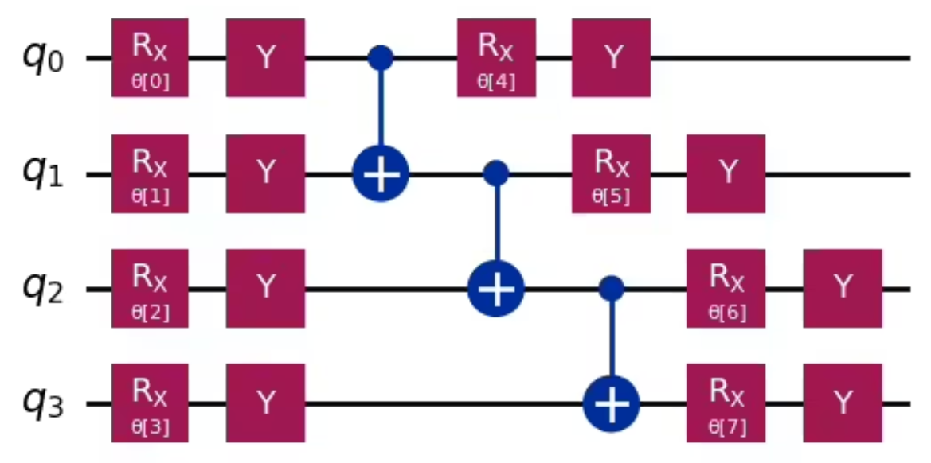
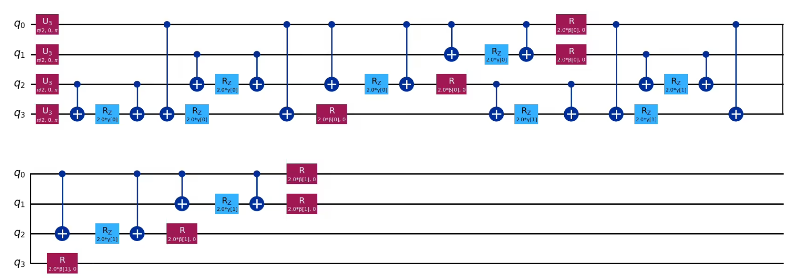

1.2. Circuit ansatz Existing ansatzes
$N$ local $→$Two local ansatz
Efficient SU2 ansatz
(Domain-specific) QAOA ansatz
[1.6] https://quantum.cloud.ibm.com/learning/en/courses/variational-algorithm-design/ansaetze-and-variational-forms

Slide 8
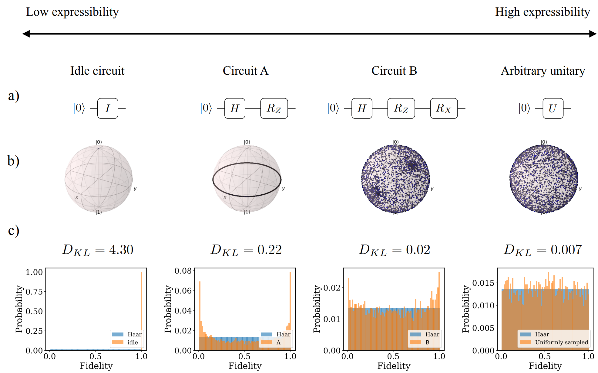
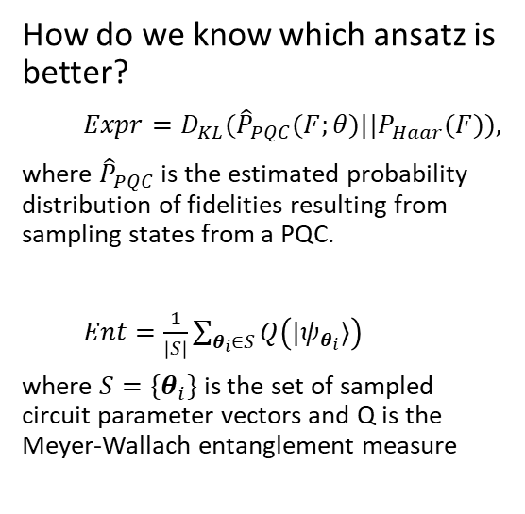
1.2. Circuit ansatz Using descriptors to measure PQC
How do we know which ansatz is better?
$Expr=D_{KL}({\hat{P}}_{PQC}(F;θ)||P_{Haar}(F)),$
where ${\hat{P}}_{PQC}$ is the estimated probability distribution of fidelities resulting from sampling states from a PQC.
$Ent=\frac{1}{\left|S\right|}\sum_{θ_{i}∈S}{Q\left(|ψ_{θ_{i}}⟩\right)}$
where $S=\{θ_{i}\}$is the set of sampled circuit parameter vectors and Q is the Meyer-Wallach entanglement measure
Expressibility
Entangling capability
[1.7] Sim, S., Johnson, P. D., & Aspuru‐Guzik, A. (2019). Expressibility and entangling capability of parameterized quantum circuits for hybrid quantum‐classical algorithms. Advanced Quantum Technologies, 2(12), 1900070.
Notes:
Các cấu trúc graph – based, ring, nearest neighboor, all-to-all. Biến đổi một chút => các cấu trúc W

Slide 9
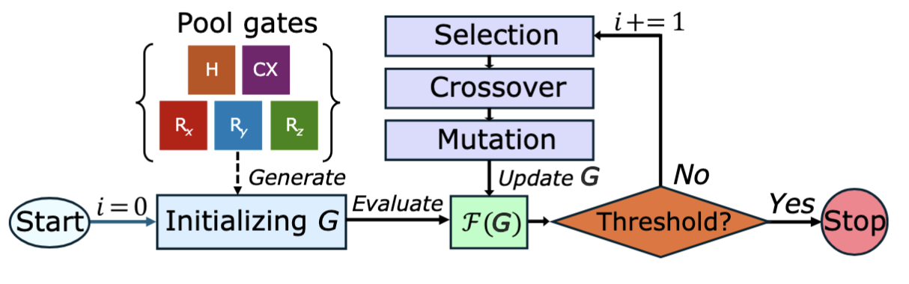
1.2. Circuit ansatz Searching problem
Question: Can we automatically find the best ansatz?
A easiest approach is the gradient-free method, such as Bayesian opt [1.8] and genetic algorithm (GA) [1.9].
[1.8] Duong, T., Truong, S. T., Tam, M., Bach, B., Ryu, J. Y., & Rhee, J. K. K. (2022). Quantum neural architecture search with quantum circuits metric and bayesian optimization. ICML 2022 Workshop AI4Science.
[1.9] Hai, V. T., Viet, N. T., Urbaneja, J., Linh, N. V., Tran, L. N., & Ho, L. B. (2024). Multi-target quantum compilation algorithm. Machine Learning: Science and Technology, 5(4), 045057.

Slide 10
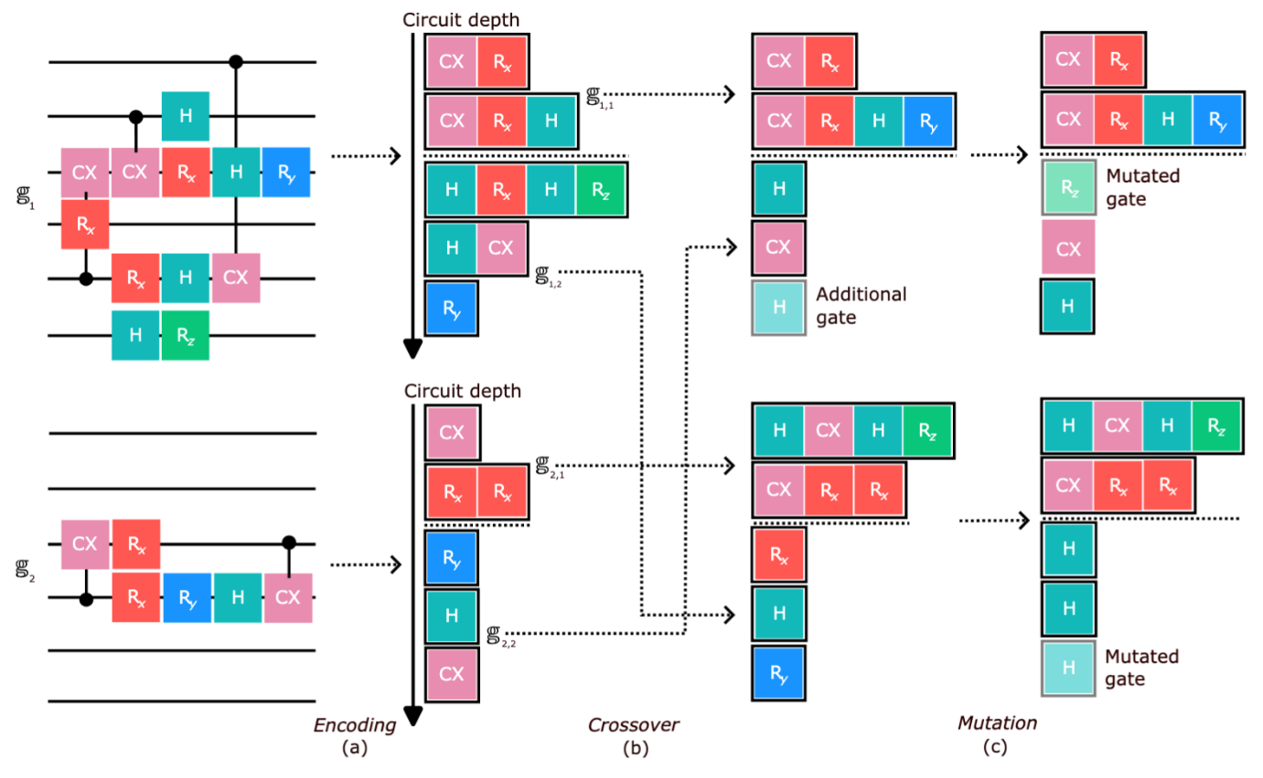
1.2. Circuit ansatz Searching problem
Question: How does an ansatz construct?
An ansatz can be built block-by-block
[1.10] Duc (2025). Flexible Genetic Algorithm for Quantum Support Vector Machines (unpublished).

Slide 11
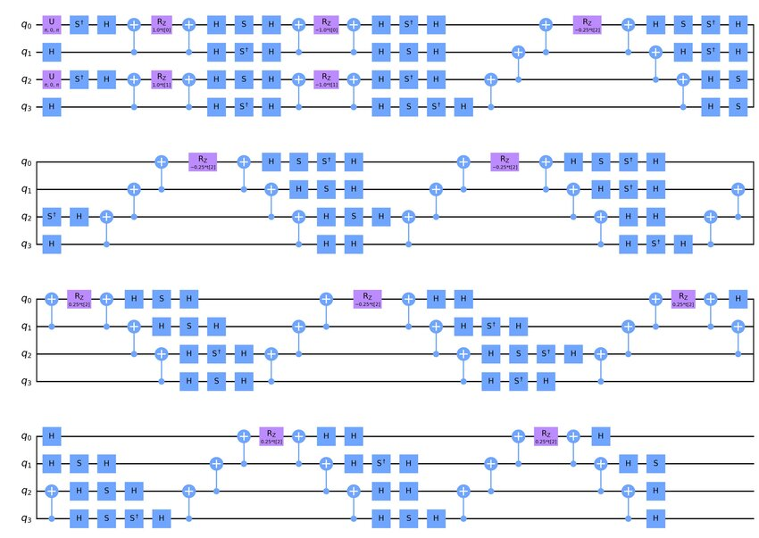
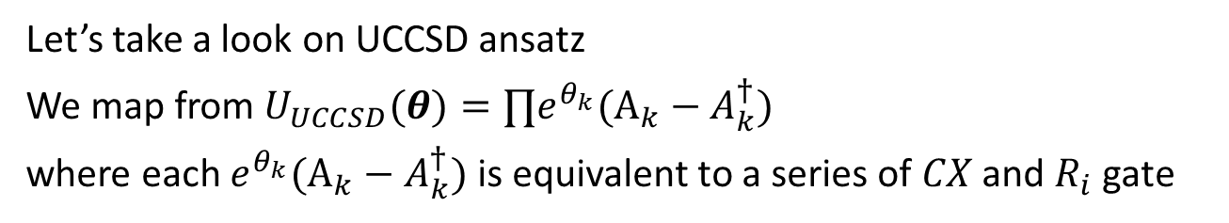

1.2. Circuit ansatz Searching problem
Let’s take a look on UCCSD ansatz
We map from $U_{UCCSD}​(θ)=∏​e^{θ_{k}}​(A_{k}​−A_{k}^{†}​)$
where each $e^{θ_{k}}​(A_{k}​−A_{k}^{†}​)$is equivalent to a series of $CX$ and $R_{i}$ gate
$$⇒$$
Pruning through optimization process (ADAPT-VQE) [*]
An adaptive ansatz for each systems
[1.11] Grimsley, H. R., Economou, S. E., Barnes, E., & Mayhall, N. J. (2019). An adaptive variational algorithm for exact molecular simulations on a quantum computer. Nature communications, 10(1), 3007.

Slide 12


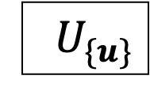



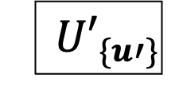





1.3. Compilation
There is a large gap between algorithms and set of instructions we can perform on real qc
Problem 1 (a): The native gate set is diff
IBM series
No $CX, R_{X}$ or $CR_{Y}$
$$\{CZ, X, R_{Z}, SX, ID\}$$
Gate synthesis
Rigetti Ankaa-3
No $CX, R_{Y}$ or $CR_{Y}$
$$\{R_{X},R_{Z}, ISWAP\}$$
If we have this example circuit:
$$H$$
$$R_{Y}$$
$$≡$$
$${ U}_{\{u\}}$$
Qubit mapping
Circuit optimization
...
$$⇒$$
Compile
$$u=\left\{R_{X,Y,Z}, CX\right\}$$
Quantum compilation stage
$${ U′}_{\{u′\}}$$
$$u′=\left\{R_{X,Z}, ISWAP\right\}$$
[1.12] Bäumer, E., Tripathi, V., Wang, D. S., Rall, P., Chen, E. H., Majumder, S., ... & Minev, Z. K. (2024). Efficient long-range entanglement using dynamic circuits. PRX Quantum, 5(3), 030339.

Slide 13
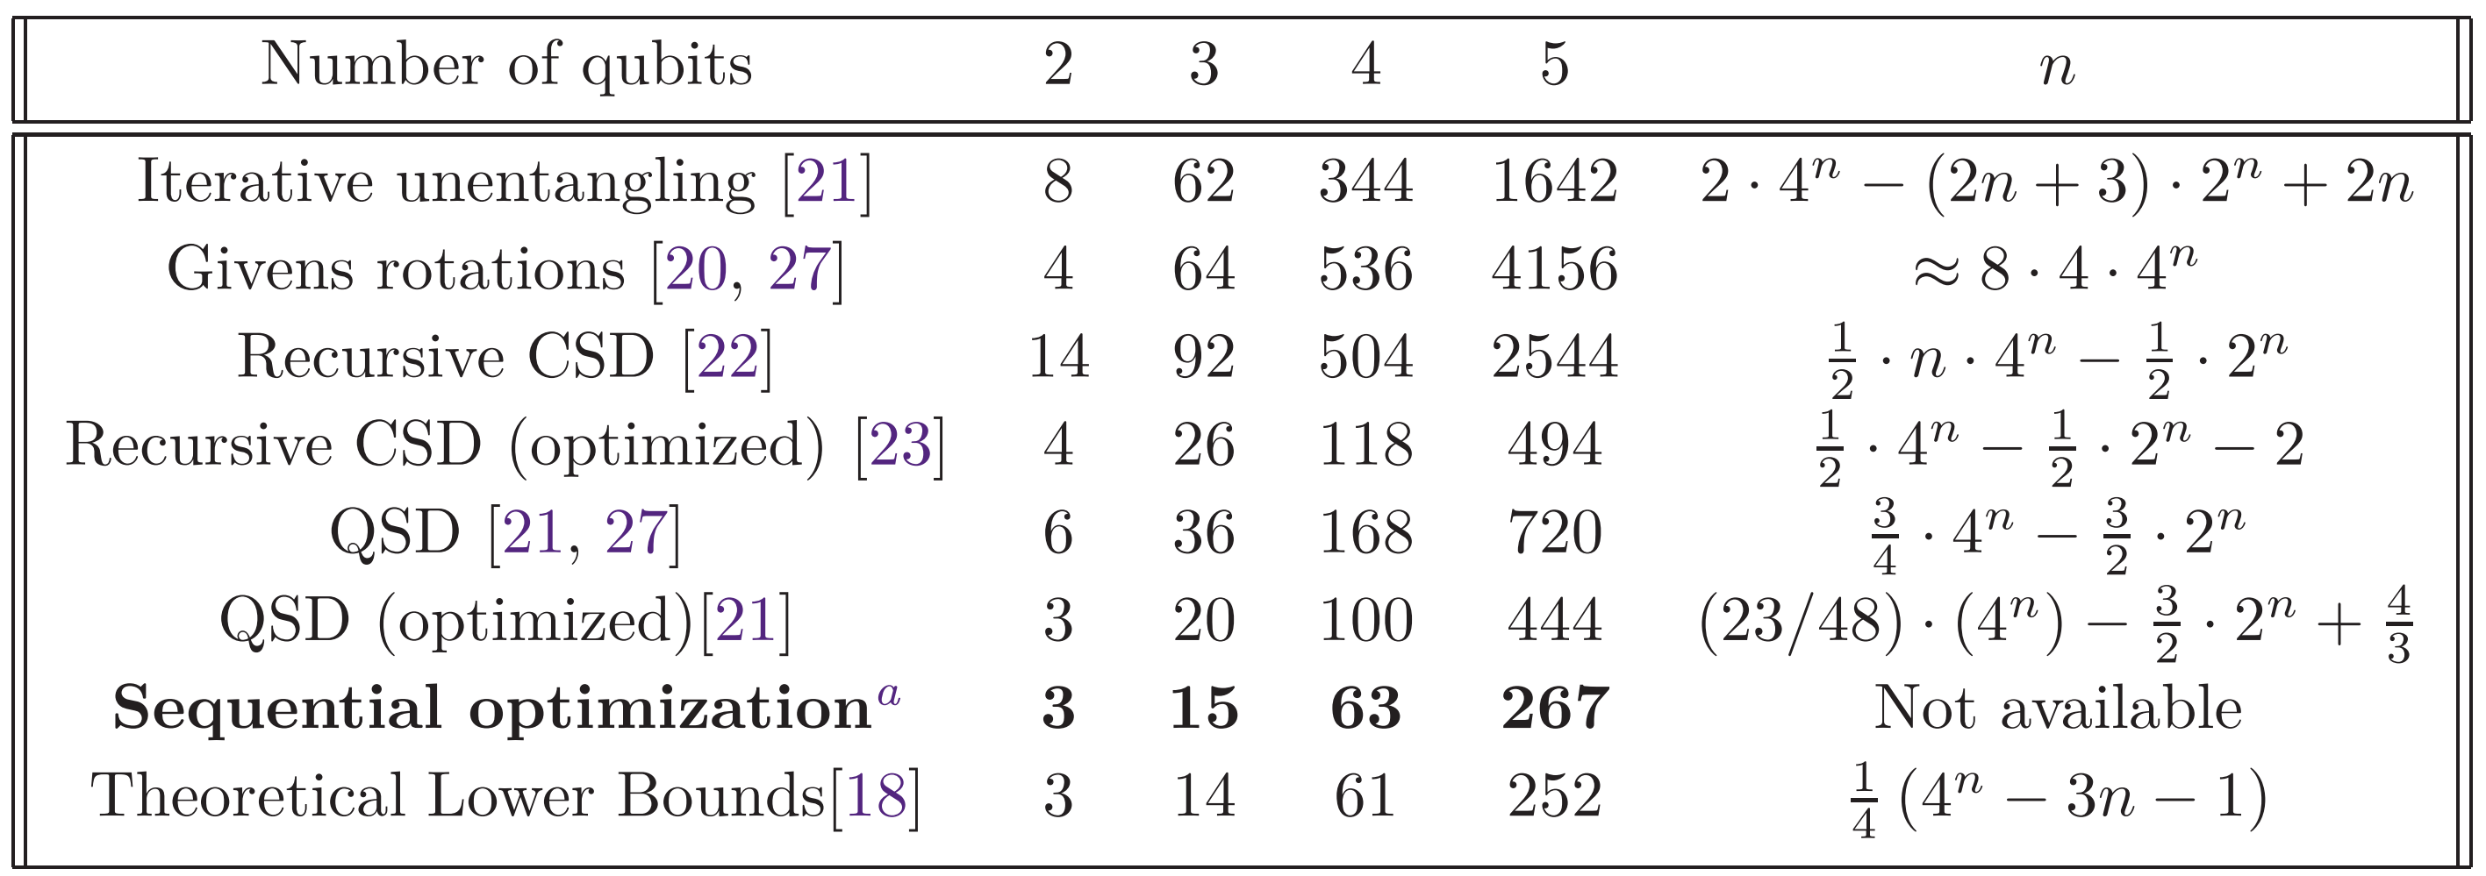


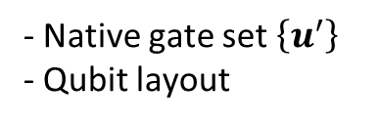

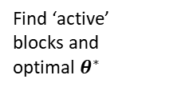








1.3. Compilation
There is a large gap between algorithms and set of instructions we can perform on real qc
Problem 1 (b): Some gates are not exist
0
$$j$$
$$U\left(θ,λ,φ\right)$$
$${ 𝒰}_{j,k}\left(θ_{j,k}\right)$$
1
$$≡$$
2
$$k$$
$$U\left(θ,λ,φ\right)$$
3
- Native gate set $\left\{u^{′}\right\}$
- Qubit layout
4
$$U$$
Find ‘active’ blocks and optimal $θ^{∗}$
$${ 𝒰}_{j,k}\left(θ_{j,k}\right)$$
Toffoli gate
Multi-control gate
$${ U′}_{\{u′\}}$$
$$n_{CX}$$
$n^{2}$ blocks for all possible $\left\{j,k\right\}$
SQUANDER package [1.13]
Note that there is a theoretical limit (lower bound) for synthesize circuit!
[1.13] Rakyta, P., & Zimborás, Z. (2022). Approaching the theoretical limit in quantum gate decomposition. Quantum, 6, 710.

Slide 14
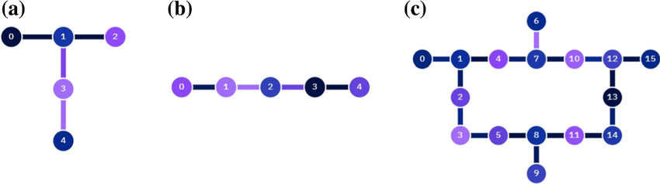
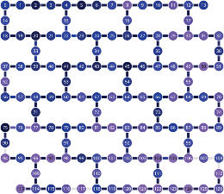
1.3. Compilation
There is a large gap between algorithms and set of instructions we can perform on real qc
Problem 2: Not all qubits are connected together
ibmq_vigo
ibmq_manila
Limited topologies
ibmq_eagle
Unlimited topologies
0
Dynamic circuit [*]
1
2
Transpile
3
4
Eligible
Not eligible
[1.14] https://quantum.cloud.ibm.com/computers
[1.15] Bäumer, E., Tripathi, V., Wang, D. S., Rall, P., Chen, E. H., Majumder, S., ... & Minev, Z. K. (2024). Efficient long-range entanglement using dynamic circuits. PRX Quantum, 5(3), 030339.

Slide 15
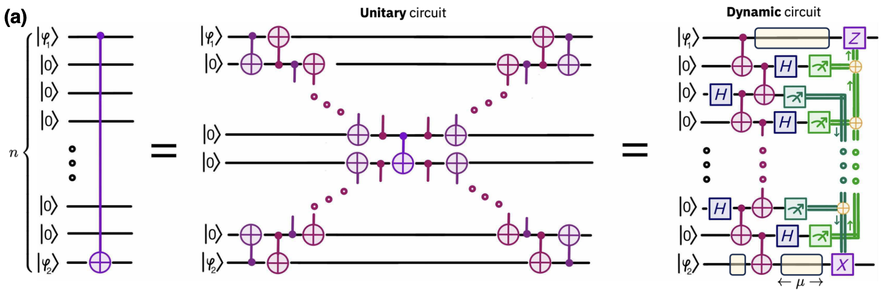
1.3. Compilation
Problem 2: Not all qubits are connected together
Old transpilation method
New transpilation method
A single CX gate
Dynamic circuit [*]
Transpile
[1.16] Bäumer, E., Tripathi, V., Wang, D. S., Rall, P., Chen, E. H., Majumder, S., ... & Minev, Z. K. (2024). Efficient long-range entanglement using dynamic circuits. PRX Quantum, 5(3), 030339.

Slide 16
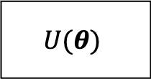

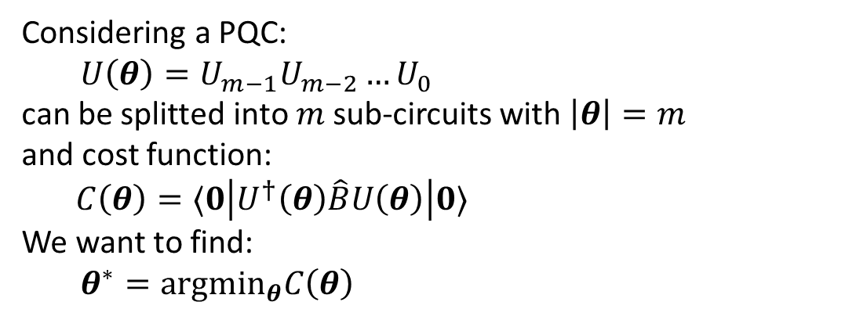



1.4. Gradient and optimizer
Considering a PQC:
$U\left(θ\right)=U_{m−1}U_{m−2}…U_{0}$
can be splitted into $m$ sub-circuits with $\left|θ\right|=m$
and cost function:
$C\left(θ\right)=⟨0\left|U^{†}\left(θ\right)\hat{B}U\left(θ\right)\right|0⟩$
We want to find:
$θ^{∗}={argmin}_{θ}C\left(θ\right)$
Gradient
$$U(θ)$$
$$C\left(θ\right)$$
$$∇C$$
$θ^{t+1}←$ Optimizer$(θ,∇C)$
Update $θ$ until $C\left(θ\right)<τ$

Slide 17
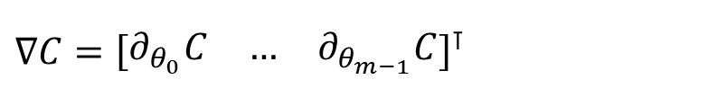
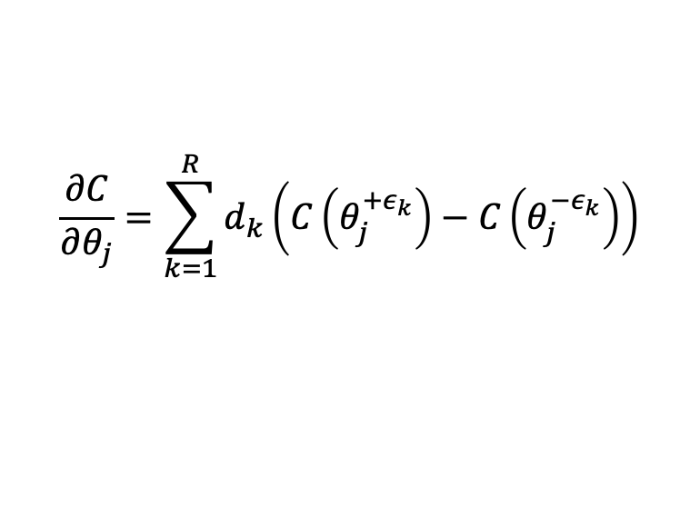
1.4. Gradient
Computing PQC’s gradient is the key in quantum optimization:
$∇C={\left[\begin{matrix}∂_{θ_{0}}C & … & ∂_{θ_{m−1}}C\end{matrix}\right]}^{⊺}$
The partial derivative can be computed through parameter-shift rule [1.17]:
$$\frac{∂C}{∂θ_{j}}=\sum_{k=1}^{R}{d_{k}\left(C\left(θ_{j}^{+ε_{k}}\right)−C\left(θ_{j}^{−ε_{k}}\right)\right)}$$
and $C\left(θ_{j}^{+ε_{k}}\right)≡C\left(θ+e_{j}ε_{k}\right)$, $e_{j}$ is the $j^{th}$ unit vector, $ε_{k}$ is the shift-value
[1.17] D. Wierichs, J. Izaac, C. Wang, and C. Y.-Y. Lin, “General parameter-shift rules for quantum gradients,” Quantum, vol. 6, p. 677, Mar. 2022

Slide 18
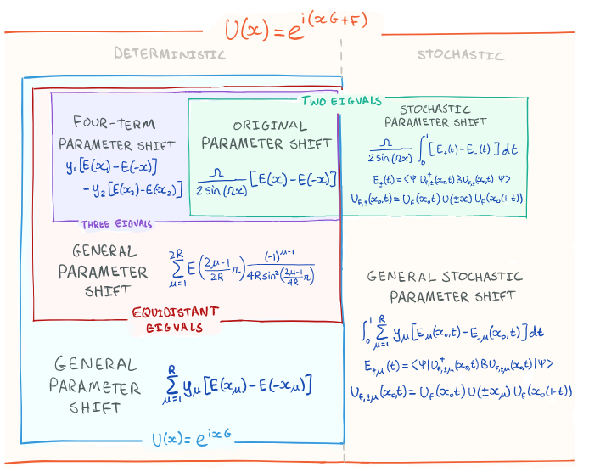
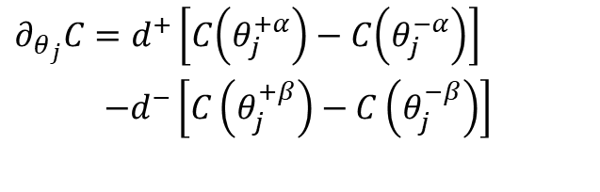
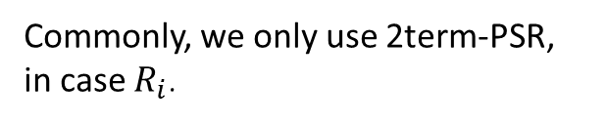

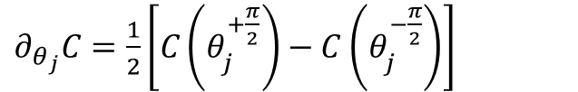

1.4. Gradient Parameter-shift rule
Commonly, we only use 2term-PSR,
in case $R_{i}$.
$∂_{θ_{j}}C=\frac{1}{2}\left[C\left(θ_{j}^{+\frac{π}{2}}\right)−C\left(θ_{j}^{−\frac{π}{2}}\right)\right]$
4term-PSR is used in case control-$R_{i}$.
$∂_{θ_{j}}C=d^{+}\left[C\left(θ_{j}^{+α}\right)−C\left(θ_{j}^{−α}\right)\right]$
$−d^{−}\left[C\left(θ_{j}^{+β}\right)−C\left(θ_{j}^{−β}\right)\right]$
Take $2m/4m$ quantum evaluations for a single gradient!
$f\left(x\right)=\sin{x},f^{′}\left(x\right)=\frac{1}{2}\left[\sin\left(x+\frac{π}{2}\right)−sin⁡(x−\frac{π}{2})\right]$ $=\frac{1}{2}\left[\cos\left(x\right)+cos⁡(x)\right]$ $=cos⁡(x)$
Notes:
Cho C là loss/cost function, tính đạo hàm riêng thứ i bằng phương pháp sai phân hữu hạn, tuy nhiên trong trường hợp này ta tính các hệ số cụ thể. Với các eigenvalues khác nhau, độ dời s và hệ số tự do r sẽ có giá trị khác nhau.
Cách tính cụ thể được trình bày trong paper.

Slide 19
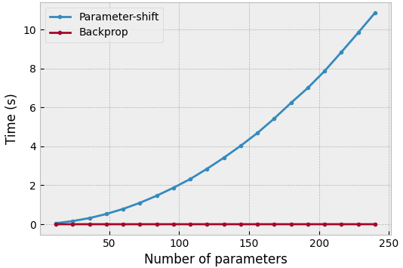
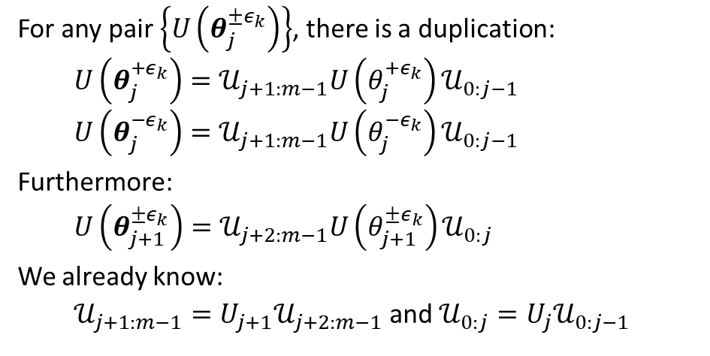

1.4. Gradient Parameter-shift rule with backpropagation
$𝒰_{i:j}=U_{j}U_{j−1}…U_{i}$
Quantum backpropagation [1.18,1.19] requires only a single quantum evaluations
For any pair $\left\{U\left(θ_{j}^{±ε_{k}}\right)\right\}$, there is a duplication:
$U\left(θ_{j}^{+ε_{k}}\right)=𝒰_{j+1:m−1}U\left(θ_{j}^{+ε_{k}}\right)𝒰_{0:j−1}$
$U\left(θ_{j}^{−ε_{k}}\right)=𝒰_{j+1:m−1}U\left(θ_{j}^{−ε_{k}}\right)𝒰_{0:j−1}$
Furthermore:
$U\left(θ_{j+1}^{±ε_{k}}\right)=𝒰_{j+2:m−1}U\left(θ_{j+1}^{±ε_{k}}\right)𝒰_{0:j}$
We already know:
$𝒰_{j+1:m−1}=U_{j+1}𝒰_{j+2:m−1}$ and $𝒰_{0:j}=U_{j}𝒰_{0:j−1}$
[1.18] https://pennylane.ai/qml/demos/tutorial_backprop
[1.19] Hai, V. T., Luan, P. H., & Nakashima, Y. (2024, October). Efficient Parameter-Shift Rule Implementation for Computing Gradient on Quantum Simulators. ATC (pp. 449-454). IEEE.

Slide 20
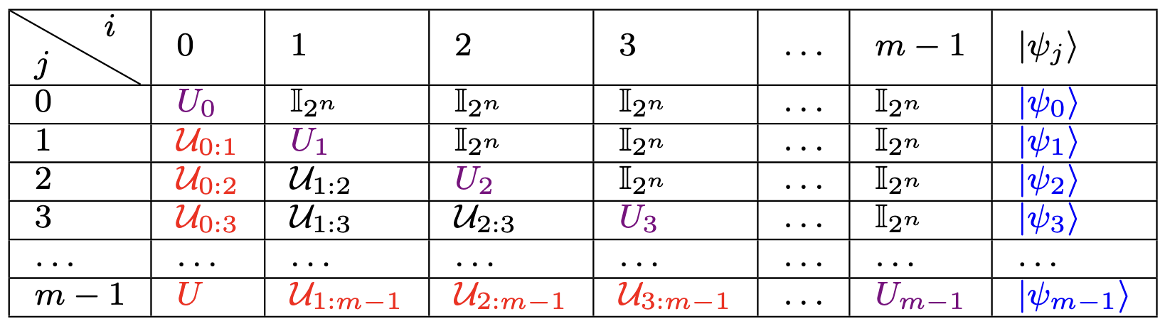
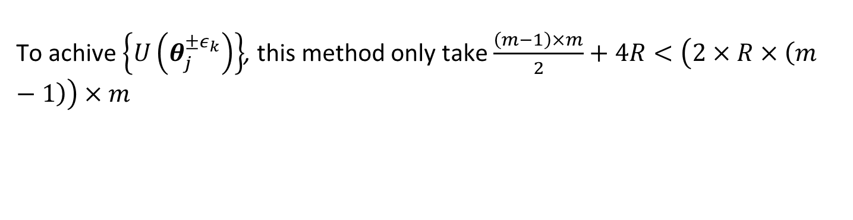
1.4. Gradient Parameter-shift rule with backpropagation
Table. Look up table (LUT) for ${\left\{U_{i:j}\right\}}_{i,j}∈[0,m−1]$. Red and Blue elements are required for MM-based and state-based simulators, respectively. Violet elements are required for both.
To fill this LUT, only take $\sum_{j=0}^{m−1}{j}=\frac{\left(m−1\right)×m}{2}$ matrix multiplication
To achive $\left\{U\left(θ_{j}^{±ε_{k}}\right)\right\}$, this method only take $\frac{\left(m−1\right)×m}{2}+4R<\left(2×R×\left(m−1\right)\right)×m$

Slide 21
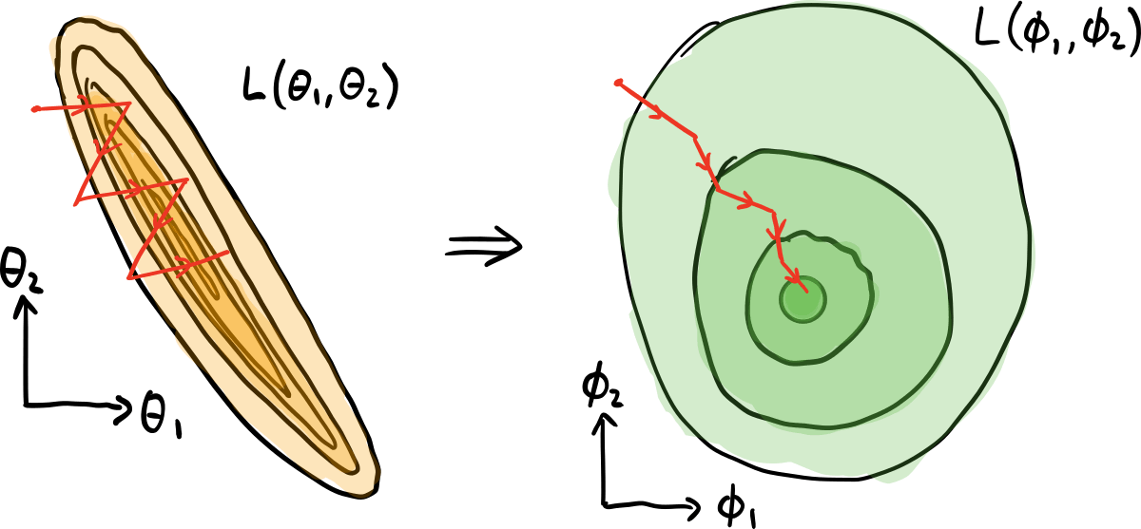


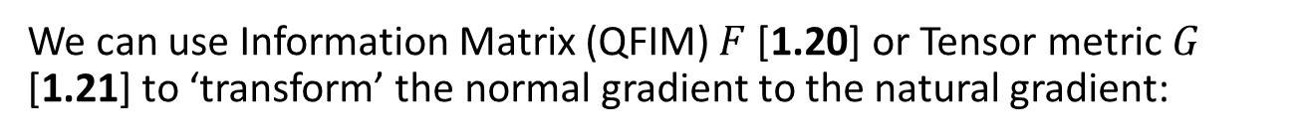

1.4. Gradient Tensor metric
The same idea as Hessian matrix
We can use Information Matrix (QFIM) $F$[1.20] or Tensor metric $G$ [1.21] to ‘transform’ the normal gradient to the natural gradient:
$$F_{j,k}(θ) = 4ℜe [⟨{∂_{θ}}_{j}ψ|∂_{θ_{k}}ψ⟩− ⟨{∂_{θ}}_{j}ψ|ψ⟩⟨ψ|∂_{θ_{k}}ψ⟩]$$
$$g_{j,k}^{\left(ℓ\right)} = ⟨ψ_{\left(ℓ\right)−1} \left|K_{j}K_{k}\right|ψ_{\left(ℓ\right)−1}⟩− ⟨ψ_{\left(ℓ\right)−1}\left|K_{j}\right|ψ_{\left(ℓ\right)−1}⟩ ⟨ψ_{\left(ℓ\right)−1}\left|K_{k}\right|ψ_{\left(ℓ\right)−1}⟩$$
This ‘new’ gradient can be used as normal gradient, for example SGD:
$$θ^{t+1} ←θ^{t}−α∇_{θ}C$$
Pseudo-inverse of $F$
$$θ^{t+1} ←θ^{t}−α\left( {F^{+} ∇}_{θ}C\right)$$
[1.20] Meyer, J. J. (2021). Fisher information in noisy intermediate-scale quantum applications. Quantum, 5, 539.
[1.21] Stokes, J., Izaac, J., Killoran, N., & Carleo, G. (2020). Quantum natural gradient. Quantum, 4, 269.

Slide 22
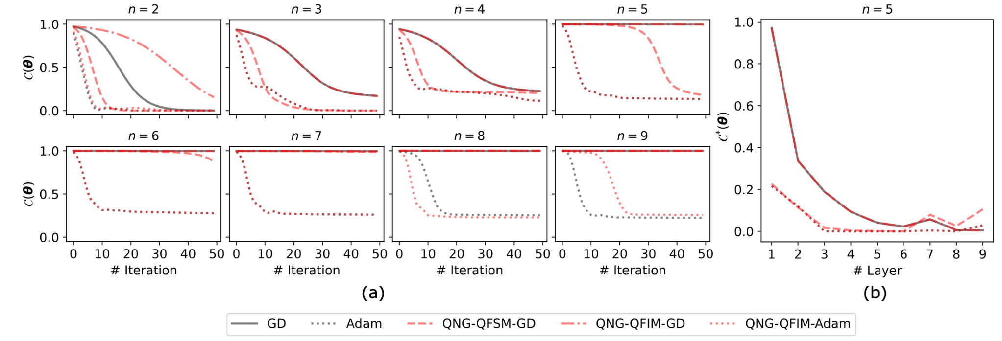
1.4. Optimizer
We can use classical optimizers such as Adam in quantum optimization problems.
[1.22] Hai, V. T., Luan, P. H., & Nakashima, Y. (2024, November). Benchmarking Classical and Quantum Optimizers for Quantum Simulator. In 2024 Twelfth International Symposium on Computing and Networking (CANDAR) (pp. 238-244). IEEE.

Slide 23
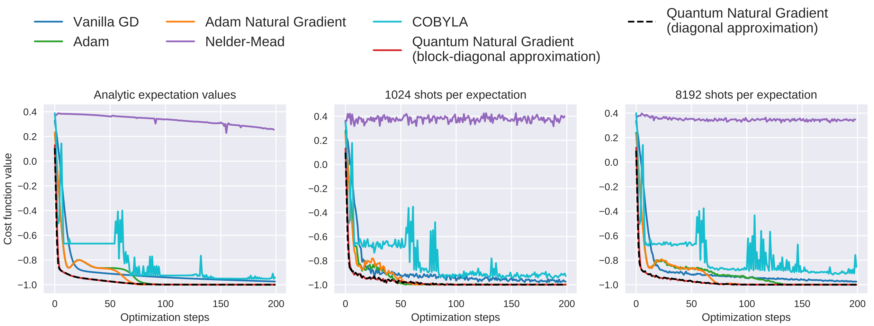
1.4. Optimizer
Note that we can also use gradient-free optimizers: Nelder-Mead, COBYLA [1.23]
[1.23] Stokes, J., Izaac, J., Killoran, N., & Carleo, G. (2020). Quantum natural gradient. Quantum, 4, 269.

Slide 24
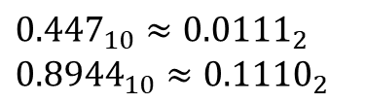

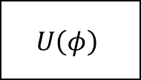












1.5. Encoding Quantum state preparation
$$U\left(φ\right)$$
$$\left|ψ_{0}\right\rangle ={\left|0\right\rangle }^{⊗n}$$
$$\left|ψ′\right\rangle =U\left(φ\right)|ψ_{0}⟩$$
with $\left|ψ′\right\rangle$ is the prepared/embedded state
How to prepare $U\left(φ\right)?$
For example: $\left|ψ′\right\rangle =\left[\begin{matrix}1/\sqrt{5} & 2/\sqrt{5}\end{matrix}\right]$
$${0.447}_{10}≈{0.0111}_{2}$$
$${0.8944}_{10}≈{0.1110}_{2}$$
$$|0⟩$$
$${ R}_{Y}\left(2.2143\right)$$
$$\left|ψ′\right\rangle =\left[\begin{matrix}1/\sqrt{5} \\ 2/\sqrt{5}\end{matrix}\right]$$
$$|0⟩$$
$$1/\sqrt{5}$$
$n$qubits
$$|0⟩$$
$$X$$
$$|0⟩$$
$$X$$
${M2}^{n}$qubits
$$|0⟩$$
$$X$$
$$|0⟩$$
$$X$$
$$2/\sqrt{5}$$
$$|0⟩$$
$$X$$
$$|0⟩$$
$$X$$
How to find $φ?$
$$|0⟩$$
Basic encoding
Amplitude encoding
[1.24] Schuld, M., & Petruccione, F. (2018). Supervised learning with quantum computers. Quantum science and technology, 17.

Slide 25
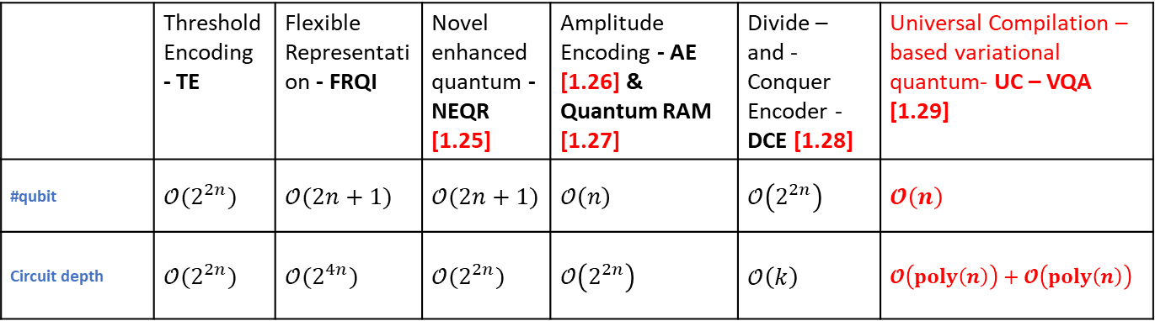

1.5. Encoding Diff encoders
Encoder
 | Threshold Encoding - TE | Flexible Representation - FRQI | Novel enhanced quantum - NEQR [1.25] | Amplitude Encoding - AE [1.26] & Quantum RAM [1.27] | Divide – and - Conquer Encoder - DCE [1.28] | Universal Compilation – based variational quantum- UC – VQA [1.29]
#qubit | $𝒪(2^{2n})$ | $𝒪(2n+1)$ | $𝒪(2n+1)$ | $𝒪\left(n\right)$ | $𝒪\left(2^{2n}\right)$ | $𝓞\left(n\right)$
Circuit depth | $𝒪(2^{2n})$ | $𝒪(2^{4n})$ | $𝒪(2^{2n})$ | $𝒪\left(2^{2n}\right)$ | $𝒪\left(k\right)$ | $𝓞\left(poly\left(n\right)\right)+𝓞\left(poly\left(n\right)\right)$
Feature
List of encoders
Circuit depth
Resource for $θ_{φ}$
[1.25] Zhang, Y., Lu, K., Gao, Y., & Wang, M, NEQR: a novel enhanced quantum representation of digital images. Quantum information processing, 12, 2833-2860 (2013).
[1.26] M. Weigold et al, Data encoding patterns for quantum computing, in Proceedings of the 27th Conference on Pattern Languages of Programs PLoP ’20, (The Hillside Group, USA, 2022).
[1.27] V. Giovannetti et al, Quantum random access memory, Phys. Rev. Lett. 100 (Apr 2008) p. 160501.
[1.28] I. F. Araujo et al, A divide-and-conquer algorithm for quantum state preparation, Scientific Reports 11 (Mar 2021) p. 6329.
[1.29] Hai, V. T., & Ho, L. B. (2023). Universal compilation for quantum state tomography. Scientific Reports, 13(1), 3750
Notes:
No. qubit = number of qubit
Circuit depth = độ dài của U_phi

Slide 26
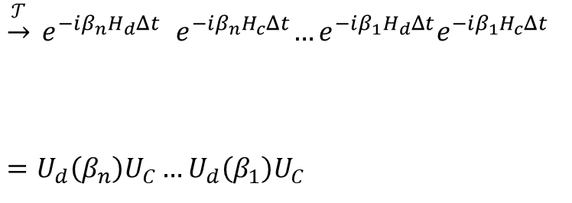
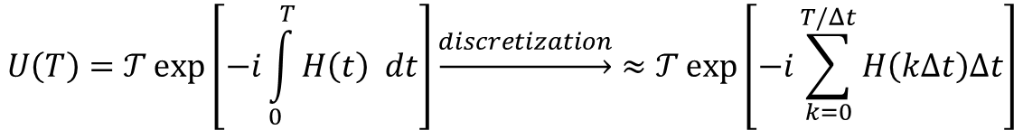
1.5. Encoding Time-evolution Unitary approximation
Implementing a time evolution unitary in a quantum circuit is difficult, so we use a Trotter-Suzuki decomposition to perform approximate time evolution. We then have:
$$U\left(T\right)=𝒯\exp\left[−i\int_{0}^{T}{H\left(t\right) dt}\right]\underset{→}{discretization}≈𝒯\exp\left[−i\sum_{k=0}^{T/Δt}{H\left(kΔt\right)Δt}\right]$$
Time-ordering operator
Target
$\underset{→}{𝒯} e^{−iβ_{n}H_{d}Δt}{ e}^{−iβ_{n}H_{c}Δt}…e^{−iβ_{1}H_{d}Δt}e^{−iβ_{1}H_{c}Δt}$
$=U_{d}\left(β_{n}\right)U_{C}…U_{d}\left(β_{1}\right)U_{C}$
Implemented by rotation gates
Quantum circuit

Slide 27



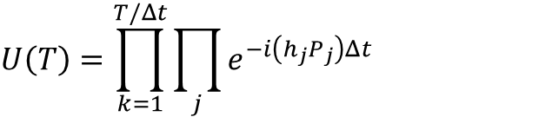



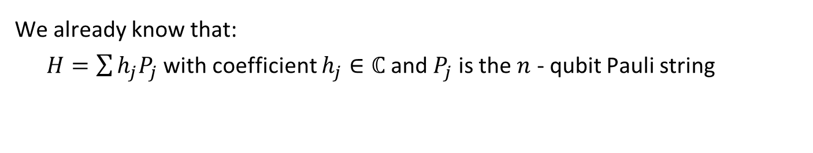











1.5. Encoding Time-evolution Unitary approximation
We already know that:
$H=\sum{h_{j}P_{j}}$with coefficient $h_{j}∈ℂ$and$P_{j}$is the $n$ - qubit Pauli string
$$U\left(T\right)=\prod_{k=1}^{T/Δt}{\prod_{j}^{ }{e^{−i\left(h_{j}P_{j}\right)Δt}}}$$
Example
$${ e}^{−i\left(Y_{0}Z_{1}\right)\left(\frac{θ}{2}\right)}$$
$$Z=\left(HS^{†}\right)Y\left(SH\right)$$
$${ e}^{−i\left(Z_{0}Z_{1}\right)\left(\frac{θ}{2}\right)}$$
$$H$$
$$S^{†}$$
$$S$$
$$H$$
$${ e}^{−i\left(h_{0}P_{0}\right)Δt}$$
$${ e}^{−i\left(h_{1}P_{1}\right)Δt}$$
$$…$$
$$CX_{0−1}R_{Z}{\left(θ\right)}_{0}CX_{0−1}$$
$$H$$
$$S^{†}$$
$$R_{Z}\left(θ\right)$$
$$S$$
$$H$$
$T/Δt$ times
[1.30] qml.ApproxTimeEvolution

Slide 28



1.6. Quantum optimization
Considering a PQC:
$U\left(θ\right)=U_{m−1}U_{m−2}…U_{0}$
can be splitted into $m$ sub-circuit with $\left|θ\right|=m$
and cost function:
$C\left(θ\right)=⟨0\left|U^{†}\left(θ\right)\hat{B}U\left(θ\right)\right|0⟩$
We want to find:
$θ^{∗}={argmin}_{θ}C\left(θ\right)$
Trainable parameters
Objective associated with expectation values
Optimal parameters
$$U(θ)$$
$$C\left(θ\right)$$
$$∇C$$
$θ^{t+1}←$ Optimizer$(θ,∇C)$
Update $θ$ until $C\left(θ\right)<τ$
Quantum computer
Classical computer

Slide 29



















1.6.1. Quantum optimization Variational Quantum Eigensolver (VQE)
associated with Hamiltonian $H=\sum_{i=0}^{M}{h_{i}}P_{I}$
Finding ground energy $E_{0}$ corresponding to ground state $\left|ψ_{0}\right\rangle$ of Hamiltonian $H$
$$U(θ)$$
Solution!
$$h_{0}⟨\hat{P_{0}}⟩$$
$$H\left|ψ_{0}\right\rangle =E_{0}|ψ_{0}⟩$$
True
$$+$$
$$⇒$$
$$⋮$$
$$⋮$$
$$⋮$$
$$E$$
$$E≤E_{0}?$$
Quantum state preparation
$$U(θ)$$
$$+$$
False
$$h_{M}⟨\hat{P_{M}}⟩$$
Update $θ$
Simple Hamiltonian: ${\hat{​H}}_{Ising}=−\sum_{i}{J_{i}​Z_{i}​Z_{i+1}}$ $​−\sum_{i}{{h_{i}X}_{i}}​$
Electronic structure $→\text{Basis} \text{set} \text{expansion}\text{ (}\text{ex}\text{: }\text{sto}\text{3}\text{g}\text{)}$
$→$ Mapping to qubits (ex: JW transform)
$→$ Pauli decomposition $→$ $\hat{H}$
[1.31] https://pennylane.ai/qml/demos/tutorial_vqe_intro

Slide 30



















1.6.1. Quantum optimization VQE $→$ AdaptVQE
$${ U}_{0}$$
$${ U}_{1}$$
$${ U}_{n}$$
$$⋮$$
$$\left\{{\hat{A}}_{m}\right\}$$
False $→$ Add more operator
Measure partial derivates $\left\{∂_{θ_{j}}C\right\}$
Heavy pre-constructed ansatz
$$\{∂_{θ_{0}}C$$
$$∂_{θ_{1}}C$$
$$∂_{θ_{n}}C\}$$
AdaptVQE
Select largest’s $∂_{θ_{j}}C$ operators
$${ U}_{1}$$
$${ U}_{3}$$
$${ U}_{n/2}$$
Reoptimize
$${ U}_{1}$$
$$⋮$$
$$E≤E_{0}?$$
True $→$ Done
For LiH
[1.32] Grimsley, H. R., Economou, S. E., Barnes, E., & Mayhall, N. J. (2019). An adaptive variational algorithm for exact molecular simulations on a quantum computer. Nature communications, 10(1), 3007.

Slide 31









1.6.2. Quantum optimization Quantum Approximate Optimization Algorithm (QAOA)
$$U\left(γ,β\right)$$
$$e^{−iγ_{n}H_{C}}$$
$$e^{−iβ_{n}H_{M}}$$
Quantum state preparation
$$E$$
$$E≤E_{0}?$$
Min/Max cut
False $→$ Update $\left\{γ,β\right\}$
Implemented by quantum gates
1. Problem Definition (QUBO)
$2. \text{Ising} \text{Hamiltonian}\text{: }{\hat{​H}}_{Ising}=−\sum_{i}{J_{i}​z_{i}​z_{i+1}}−h_{i}∑​z_{i}​ \left(z_{i}∈\left\{±1\right\}\right)$
3. Find optimal $\left\{γ^{∗},β^{∗}\right\}$
Vehicle routing
[1.33] https://pennylane.ai/qml/demos/tutorial_qaoa_intro

Slide 32


























1.6.2. Quantum optimization QAOA$→$ FALQON
$${\left\langle i\left[H_{d},H_{c}\right]\right\rangle }_{k}≡⟨ψ_{1}|i\left[H_{d},H_{c}\right]|ψ_{1}⟩$$
Step
$${ U}_{c}$$
$${ U}_{d}\left(β_{1}\right)$$
$$k=1$$
$${\left\langle i\left[H_{d},H_{c}\right]\right\rangle }_{1}$$
$$β_{2}=−{\left\langle i\left[H_{d},H_{c}\right]\right\rangle }_{1}∗Δt$$
Repeat $k=1$ to $n$:
1. Prepare$\left|ψ_{k}\right\rangle =U_{d}\left(β_{k}\right)U_{c}…U_{d}\left(β_{1}\right)U_{c}|ψ_{0}⟩$
2. Measure the expectation value ${\left\langle i\left[H_{d},H_{c}\right]\right\rangle }_{k}$
3. Set $β_{k+1}=−{\left\langle i\left[H_{d},H_{c}\right]\right\rangle }_{k}∗Δt$
$${ U}_{c}$$
$${ U}_{d}\left(β_{1}\right)$$
$${ U}_{c}$$
$${ U}_{d}\left(β_{2}\right)$$
$${\left\langle i\left[H_{d},H_{c}\right]\right\rangle }_{2}$$
$$…$$
$$…$$
$$β_{k+1}=−{\left\langle i\left[H_{d},H_{c}\right]\right\rangle }_{k}∗Δt$$
$$…$$
$${ U}_{c}$$
$${ U}_{d}\left(β_{1}\right)$$
$$…$$
$${ U}_{c}$$
$${ U}_{d}\left(β_{n}\right)$$
$$⟨ψ_{n}|H_{c}|ψ_{n}⟩$$
$$k=n$$
Ground energy
1. Problem Definition
$2.\text{Hamiltonian} {H=H}_{c}+β\left(t\right){ H}_{d}$
3. Find ground energy corresponding to $H_{c}$
Objective
Avoid local minimals
[1.34] https://pennylane.ai/qml/demos/tutorial_falqon

Slide 33






























1.6.3. Quantum Optimization Quantum compiling
$$U$$
$$V$$
$p_{0}\left(θ\right)$
$$C\left(θ\right)=1−p_{0}$$
False $→$ Update $θ$
$$C\left(θ\right)<τ?$$
Transfer
$$U\left(θ\right)$$
$$V^{†}$$
$$U\left(θ^{∗}\right)$$
$$V^{†}$$
$$V$$
$$V^{†}$$
$$p_{0}≈1$$
$$⇒$$
$$≡$$
Preparation
Trainable unitary
Target unitary
Optimized unitary
Target unitary
Explicity
Unknown
Transfer
$$U$$
$$V\left(θ\right)$$
$$U$$
$$V\left(θ^{∗}\right)$$
$$U$$
$${ U}^{†}$$
$$⇒$$
$$≡$$
Tomography
Target unitary
Trainable unitary
Target unitary
Optimized unitary
Explicity
Unknown
[1.35] Hai, V. T., Viet, N. T., & Ho, L. B. (2024). SoftwareX, 26, 101726. https://doi.org/10.1016/j.softx.2024.101726

Slide 34













1.6.3. Quantum Optimization Quantum compiling
Some entangled states are hard for preparation:
$\left|GHZ_{n}\right\rangle =\frac{1}{\sqrt{2}}\left({\left|0\right\rangle }^{⊗n}+{\left|1\right\rangle }^{⊗n}\right)$
$\left|W_{n}\right\rangle =\frac{1}{\sqrt{n}}\left(\left|0\right\rangle +\left|1\right\rangle +…+|n⟩\right)$
$$U\left(θ^{∗}\right)$$
$$GHZ^{†}$$
then preparing $|GHZ⟩$ through $U\left(θ^{∗}\right)$ is better
If
$$≡$$
Preparation
Almost unitaries acts as “black-box”
$$V\left(θ^{∗}\right)$$
$$U$$
we know structure of $U$ via $V\left(θ^{∗}\right)$
$$U$$
only being extracted via measurement
If
$$≡$$
Tomography
[1.36] Hai, V. T., & Urbaneja, J. (2025, July). Entangled State Preparation via Cluster States on Quantum Computers with $⟨qo|op⟩$ Software. In 2025 IEEE International Conference on Quantum Software (QSW) (pp. 116-122). IEEE.
[1.37] Hai, V. T., & Ho, L. B. (2023). Universal compilation for quantum state tomography. Scientific Reports, 13(1), 3750.

Slide 35



1.7. Additional informations Barren platueas
Analyze a PQC, these term:
$𝔼\left[\frac{∂\left\langle H\right\rangle }{∂θ_{i}}\right]=\left\langle ∂C\right\rangle ,$
$Var\left[\frac{∂\left\langle H\right\rangle }{∂θ_{i}}\right]=\left\langle ∂C^{2}\right\rangle −{\left\langle ∂C\right\rangle }^{2}$
vanish exponentially based on #qubits.
[1.38] McClean, Jarrod R., et al. "Barren plateaus in quantum neural network training landscapes." Nature communications 9.1 (2018): 1-6.

Slide 36





















1.7. Additional informations Barren platueas (BP) $→$ A method for mitigate BP
$$R_{Y}\left(θ_{0}\right)$$
$$R_{X}\left(θ_{3}\right)$$
$$R_{Y}\left(θ_{6}\right)$$
$$R_{Y}\left(θ_{1}\right)$$
$$R_{X}\left(θ_{4}\right)$$
$$R_{Y}\left(θ_{7}\right)$$
$$R_{Y}\left(θ_{2}\right)$$
$$R_{X}\left(θ_{5}\right)$$
$$R_{Y}\left(θ_{8}\right)$$
$$×L$$
Hardware-effecitent ansatz (HEA)
$$k∈\left\{X,Y,Z\right\}$$
Different ansatz affect strongly
to the performance
$$R_{Y}\left(π/4\right)$$
$$R_{k}\left(θ_{0}\right)$$
$$R_{Y}\left(π/4\right)$$
$$R_{k}\left(θ_{1}\right)$$
$$R_{Y}\left(π/4\right)$$
$$R_{k}\left(θ_{2}\right)$$
$$×L$$
Random Pauli ansatz (RPA)
Init $U_{t}\left(θ\right)$
Check $\left\{∂_{θ_{j}}C\right\}$
Update
Replace $R_{k}\left(θ_{j}\right)$ by $R_{k′}\left(θ_{j}\right)$
True
Any $∂_{θ_{j}}C$?
False
End
[1.39] Ho, L. B., Urbaneja, J., & Ashhab, S. (2025). Statistical analysis of barren plateaus in variational quantum algorithms. arXiv preprint arXiv:2508.08915.

Slide 37



1.7. Additional informations Can we apply classical techniques into quantum optimization?
Consider a set of $K$ optimization targets denoted as $T_{1}, T_{2}, …,T_{K}$, all defined over the same search space $S$. Each target $T_{k}$ is associated with its own cost function:
$$C\left(θ_{\left(k\right)}\right): R^{m} → \left[0, 1\right]$$
The goal of multi-target optimization is to find a set of solutions:
$$\{θ_{\left(1\right)}^{∗},θ_{\left(2\right)}^{∗},…θ_{\left(K\right)}^{∗}\}$$
[1.41] Hai, V. T., Doanh, B. C., Duong, L. V. T., Luan, P. H., & Nakashima, Y. (2025). Transfer-Based Strategies for Multi-Target Quantum Optimization. CANDAR 2025.
37

Slide 38



1.7. Additional informations Can we apply classical techniques into quantum optimization?
Warm-starting method: simply set $θ_{x_{(k)}}^{∗}$as initial parameter $θ_{y_{\left(k′\right)}}^{\left(0\right)}=θ_{x_{(k)}}^{∗}$.
If $y≈x+ε$, $x$ and $y$ are targets, considering the first-order Taylor expansion of cost function $C$ with respect to $θ$ at $θ_{x}^{∗}$ and fixed $y$, we have:
$${\tilde{θ}}_{ y}^{∗}≈θ_{x}^{∗}−\frac{∇_{θ}C_{y}\left(θ_{x}^{∗}\right)}{{\left\|∇_{θ}C_{y}\left(θ_{x}^{∗}\right)\right\|}^{2}}C_{y}\left(θ_{x}^{∗}\right)$$
Parameter estimator

Slide 39
2. Quantum machine learning (QML)
2.1. Overview
2.2. Quantum machine learning algorithms
2.3. Quantum deep learning
2.4. Additional information

Slide 40
2.1. Overview
Type of algorithm
classical
quantum
Hybrid quantum – classical learning: algorithm running on both quantum and classical computers
QC | QQ
CC
CQ
classical
QML model should resolve below classical machine learning problems:
(1) Require huge dataset
(2) High computation resources
(3) Lack of generality
Type of data
quantum
Classical model: KNN, SVM, Deep learning, …
Quantum Machine learning (QML): algorithm running on only quantum computer or both quantum / classical computers
Notes:
Làm rõ một số định nghĩa trong QML:
- QML: thuật toán machien learning có chạy trên quantum computer
- Hybrid quantum – classical learning: tập con của QML, chạy trên cả quantum và classical computer. => Được chú ý hiện nay vì các quantum algorithm yêu cầu số qubit cao => chưa thích hợp chạy vì ko có tài nguyên

Slide 41

2.1. Overview What QML models can do? Based on quantum advantage [2.2]
(1) Require huge dataset
$⇒$ Require less items
(2) High computation resources
$⇒$ Lower time complexity
(3) Lack of generality
$⇒$ Example: Require less #parameter than classical ML model or achieve higher accuracy on the same dataset.
Be careful with hype QML papers!
[2.1] Simões, R. D. M., Huber, P., Meier, N., Smailov, N., Füchslin, R. M., & Stockinger, K. (2023). Experimental evaluation of quantum machine learning algorithms. IEEE Access, 11, 6197-6208.
[2.2] Schuld, M., & Killoran, N. (2022). Is quantum advantage the right goal for quantum machine learning?. Prx Quantum, 3(3), 030101.
Notes:
Một số tiềm năng, đặc trưng của các mô hình QML đề xuất khi so sánh với mô hình ML cổ điển.

Slide 42

2.1. Overview Type of QML model
a) Speed up version of classical ML algorithms:
QKNN
QKmean
QSVM
b) Quantum analogue version of a deep learning model
- QuNN, QCNN
- QGNN
- QGAN
c) Quantum learning
$→$ I don’t know this type
Notes:
Phân chia tạm thời các lớp trong QML.
- Liên quan đến ML cổ điển: phiên bản quantum của các thuật toán truyền thống như KNN, SVM, ..
- Liên quan đến Neural network (nói đúng ra lớp này được gọi là quantum deep learninng): phiên bản quantum của các kiến ttrúc neural network khác nhau.
- pure quantum learning: các thuật toán mới hoàn toàn và ko có phiên bản cổ điển tương ứng.

Slide 43




2.1. Overview Pioneers in QML
Maria Schuld
Xanadu.ai (Pennylane)
Ryan Babbush
Google Quantum
John Preskill
Caltech
Hsin-Yuan Huang
Google Quantum AI
Notes:
Các nhà nghiên cứu nên theo dõi:
- Maria schuld: đưa ra các định nghĩa, khái niệm, triết lý, phương pháp tính, … của các mô hình QML. Thiên về lý thuyết.
- Ryan Babbush: đề xuất các mô hình QML mới và thiên về thực nghiệm

Slide 44



2.2. QML algorithms QkNN
positive
For each test data point $a$:
Step 1: Calculate ${Ds}_{a}=dist\left(a, x_{i}\right) ∀ i=1..n$
Step 2: Sort and get $k$ smallest dist in $Ds_{a}$.
Step 3: Get $k$ corresponding label and do major vote
negative
undetermined
$$k=3$$
Time complexity: $𝒪({mnn}_{test})$
where:
$m$: dimensional of $x_{i}$
$n$: # train data points
$n_{test}:$ # test data points
Notes:
Fig 2.1. mình hoạ quá trình xác định label của hình tròn màu trắng
Tóm tắt thuật toán KNN
Độ phức tạp

Slide 45



















2.2. QML algorithms QkNN
For each test data point $a$:
Step 1: Calculate
$${ Ds}_{a}=dist\left(a, x_{i}\right) ∀ i=1..n$$
Step 2: Sort and get $k$ smallest dist in $Ds_{a}$.
Step 3: Get $k$ corresponding label and major vote
$$\hat{x}=\left[\begin{matrix}\begin{matrix}1/\sqrt{14} \\ 0\end{matrix} \\ \begin{matrix}2/\sqrt{14} \\ 3/\sqrt{14}\end{matrix}\end{matrix}\right]$$
$$x=\left[\begin{matrix}\begin{matrix}1 \\ 0\end{matrix} \\ \begin{matrix}2 \\ 3\end{matrix}\end{matrix}\right]$$
Normalized
Encoded
$$R_{Y}\left(2.11\right)$$
$$R_{Y}\left(−2.86\right)$$
$$R_{Y}\left(1.48\right)$$
Fredkin-gate $≡$ SWAP
$$H$$
$$H$$
$$R_{Y}\left(2.11\right)$$
$$\left.\left|0\right\rangle \left|ψ\right\rangle |φ\right\rangle \underset{→}{H_{0}}\frac{1}{\sqrt{2}}\left(\left.\left|0\right\rangle \left|ψ\right\rangle |φ\right\rangle +\left.\left|1\right\rangle \left|ψ\right\rangle |φ\right\rangle \right)$$
$\underset{→}{\left\{SWAP_{i,j}\right\}}$ $\frac{1}{\sqrt{2}}\left(\left.\left|0\right\rangle \left|ψ\right\rangle |φ\right\rangle +\left.\left|1\right\rangle \left|φ\right\rangle |ψ\right\rangle \right)$
$$\underset{→}{H_{0}}\frac{1}{2}(\left.\left|0\right\rangle \left|ψ\right\rangle |φ\right\rangle +\left.\left|1\right\rangle \left|φ\right\rangle |ψ\right\rangle )\text{ + }\frac{1}{2}(\left.\left|0\right\rangle \left|φ\right\rangle |ψ\right\rangle −\left.\left|1\right\rangle \left|ψ\right\rangle |φ\right\rangle )$$
So $p_{0}=\frac{1}{2}\left(⟨φ|⟨ψ|+⟨ψ|⟨φ|\right)\frac{1}{2}\left(\left|φ\right\rangle \left|ψ\right\rangle +\left|ψ\right\rangle |φ⟩\right)$
$⇒\left|⟨ψ|φ⟩\right|=2p_{0}−1$
Encode $x_{i}\left(ψ\right)$
$$R_{Y}\left(−2.86\right)$$
$$R_{Y}\left(1.48\right)$$
$$p_{0}$$
$$R_{Y}\left(1.44\right)$$
$$R_{Y}\left(1.18\right)$$
Encode $x_{j}\left(φ\right)$
$$R_{Y}\left(2.5\right)$$
Swap-test procedure
[2.3] Vu Tuan Hai, Phan Hoang Chuong and Pham The Bao (2022). New approach of KNN Algorithm in quantum computing based on new design of quantum circuits. Informatica, 46(5).
Notes:
Phiên bản quantum của KNN
Ở đây thay vì tính khoảng cách 2 vector bằng máy tính cổ điển, chúng ta tính trên mạch lượng tử. Giảm độ phức tạp của công đoạn này, các bước 2,3 vẫn tính trên máy cổ điển như bình thường.

Slide 46


2.2. QML algorithms $k$-means
Step 1. Select $k$ random centers.
Step 2. Assign each data point to the closest center.
If the assigned labels do not change, then stop.
Step 3. New center = average of all assigned points
Step 4. Return to step 2.
Swap-test procedure can be applied again!
Notes:
Fig 2.1. mình hoạ quá trình xác định label của hình tròn màu trắng
Tóm tắt thuật toán KNN
Độ phức tạp

Slide 47










2.2. QML algorithms Quantum SVM
Kernel method
$$⇒$$
$$⇒$$
separate hyperplane.
Inseparable data $x={\left[\begin{matrix}x_{1} & x_{2}\end{matrix}\right]}^{⊺}$
Separable data
$φ\left(x\right)={\left[\begin{matrix}x_{1} & x_{2} & x_{1}x_{2}\end{matrix}\right]}^{⊺}$
We have:
$f^{∗}\left(x\right)=sgn(w·x±b)$,
with target ($w^{∗}$,$b^{∗}$):
$\min_{w,b,c}{\frac{1}{2}{\left\|w\right\|}_{2}^{2}+C\sum_{i=1}^{n}{ε_{i}}}$
$$\max_{β} L\left(β\right)=\sum_{i=1}^{n}{β_{i}−\frac{1}{2}}\sum_{i=1}^{n}{\sum_{j=1}^{n}{β_{i}β_{j}y_{i}y_{j} φ{\left(x_{i}\right)}^{⊺}φ\left(x_{j}\right)}}{ }$$
parameters
Inner product
$𝒪\left(M∗?\right)$ complexity
$$K\left(x_{i},x_{j}\right)≡φ{\left(x_{i}\right)}^{⊺}φ\left(x_{j}\right)$$
Kernel function is faster!

Slide 48
















2.2. QML algorithms Quantum SVM
Classical kernel:
${ K}_{RBF}\left(x_{i},x_{j}\right)=\exp\left(−γ{\left\|x_{i}−x_{j}\right\|}_{2}^{2},γ>0\right)$
${ K}_{Linear}\left(x_{i},x_{j}\right)=x_{i}^{⊺}{ x}_{j}$
Embedding
Training
$$U\left(x_{1}\right)$$
$$V(θ_{1})$$
$$U\left(x_{2}\right)$$
$$V(θ_{2})$$
Quantum kernel:
$$†$$
$$U_{φ}\left(x_{j}\right)$$
$$U_{φ}^{†}\left(x_{i}\right)$$
$$…$$
$${ R}_{X}\left(x_{i,0}\right)$$
$$⋮$$
$${ R}_{X}\left(x_{i,1}\right)$$
$$U\left(x_{M}\right)$$
$$V(θ_{M})$$
$${ R}_{X}\left(x_{i,M}\right)$$
Unitary operator as kernel
$${ p}_{0} ={\left|\left\langle U_{φ}\left(x_{j}\right) | U_{φ}\left(x_{i}\right)\right\rangle \right|}^{2}$$
Feature encoding (embedding)
(Fixed kernel)
Data re-uploading
(Trainable kernel)
“Nature” inner product

Slide 49

2.3. Quantum deep learning
Encoder
Neural net
Decoder
Quantum neural network (QNN)
[2.4] Benedetti, M et al, Parameterized quantum circuits as machine learning models. Quantum Science and Technology, 4(4), 043001 (2019)
Notes:
Vector đầu vào được ánh xạ sang không gian Hilbert $φ(x)$ bằng Encoder $U_{φ}$.
Circuit $U(θ)$ tác động và trả về $U\left(θ\right)Uφ\left(x\right){\left|0\right\rangle }^{⊗\left(n+m\right)}$.
Tập các observable $\{M_{i}\}$ hỗ trợ thao tác đo, ánh xạ trạng thái lượng tử tới không gian output thông qua hàm $f$.

Slide 50



















2.3. Quantum deep learning QNN
$$R_{Y}\left(θ_{0,1}^{\left(0\right)}\right)$$
$$R_{Y}\left(θ_{0,0}^{\left(0\right)}\right)$$
$$R_{Y}\left(θ_{0,2}^{\left(0\right)}\right)$$
$$U_{0}^{(0)}\left(θ_{0}^{(0)}\right)$$
$$V_{0}^{(0)}$$
$$…$$
$$U_{L^{\left(0\right)}}^{(0)}\left(θ_{L^{\left(0\right)}}^{(0)}\right)$$
$$V_{L^{\left(0\right)}}^{(0)}$$
$$U^{(0)}\left(θ\right)$$
$$U^{(1)}\left(θ\right)$$
$$…$$
Deep PQC as deep QNN
Successive parameterized gates are meaningless
$$U\left(θ,λ,φ\right)$$
$$≡$$
$${ R}_{X}\left(θ\right)$$
$${ R}_{Y}\left(θ\right)$$
$${ R}_{Z}\left(θ\right)$$
Note that
$$×K$$
Entangled gates ($CX$. $MCX$, Control-$U$, ...) should be appended in the middle
Then
Parameterized layer
Entangled layer
Parameterized layer
$$…$$

Slide 51

2.3. Quantum deep learning QNN
Attribute | Classical deep learning | Quantum deep learning
Main concept | Neural network | Parameterized quantum circuit (PQC)
Parameter | Weight ${\{w}_{i}\}$ in nodes | Angle value $\left\{θ_{i}\right\}$ in rotation gates $\left\{R_{X},R_{Y},R_{Z}\right\}$
Gradient | Backpropagation | General parameter-shift rule and gradient tensor metric
Optimizer | Classical optimizer | Classical optimizer + gradient-free optimizer
Loss | Various type | Associated with expectation values
Notes:
Parameterized quantum circuit : mạch lượng tử có chứa tham số
parameter-shift rule : phương pháp tính đạo hàm cho tham số thứ I
Quantum Natural Gradient: đạo hàm có nhân với ma trận G được gọi là tensor metric, ma trận G tương đương phép biến đổi cơ sở.
Expectation value $⟨ψ\left|H\right|ψ⟩$: giá trị kì vọng của một Hamiltonian, H là bài toán đang giải quyết.

Slide 52















2.3. Quantum deep learning Variational classifier for simple classification problem
$$⟨Z_{0}⟩$$
$$U_{φ}\left(x\right)$$
$$U\left(θ\right)$$
#qubits = 4
#qparam = 24
#cparam = 1
Optimizer: Adam
$$p_{0}$$
$$C\left(θ,b\right)$$
$$⨁$$
$$|0⟩$$
$$|0⟩$$
$$|0⟩$$
$$X$$
$$|1⟩$$
$$|0⟩$$
$$|0⟩$$
Update $θ,b$
classical bias $b$
$$|0⟩$$
$$|0⟩$$
Problem:
Simulate $f:x∈{\left\{0,1\right\}}^{⊗n}→y=⨁_{i}x_{i}$
Example: $f(|0100⟩)=1$
Cost function $C\left(θ,b\right)=\frac{1}{N}{\sum{\left({\hat{y}}_{i}−y_{i}\right)}}^{2}→0$
Accuracy metric $A=\frac{1}{N}∑𝕀\left(\left|y_{i}−{\hat{y}}_{i}\right|<τ\right)→1$
[2.5] https://pennylane.ai/qml/demos/tutorial_variational_classifier

Slide 53











2.3. Quantum deep learning Variational classifier for ordinary differential equation (ODE)
$$⟨Z_{0}⟩$$
Cost function:
$$C\left(θ\right)={\left[U\left(θ,x_{0}\right)−y_{0}\right]}^{2}$$
$+\sum_{j}{{\left(\frac{dU\left(θ,x_{j}\right)}{dx}−y^{′} \left(x_{j}\right) \right)}^{2}}$
$$U\left(θ\right)$$
$$p_{0}$$
$$C\left(θ\right)$$
$$⨁$$
Sampling
from $y′$
Update $θ$
Solve ODE: $y^{′}\left(x\right)=−0.5\sin\left(x\right)+0.5.$ Then find $y(x)$ $\left(y\left(x\right)=\frac{1}{2}\left(\cos\left(x\right)+x\right)\right)$.
$$\left\{∂C\left(θ\right)/∂θ_{j}\right\}$$
$$\min_{θ}{C\left(θ\right)}$$
Assume that $U\left(θ,x\right)≡y\left(x\right),$ then:
${ y}^{′}\left(x\right)=\frac{dU}{dx}=\frac{\left(U\left(θ,x+ε\right)−U\left(θ,x−ε\right)\right)}{2ε}$
We simulate $y\left(x\right)$ via $U\left(θ,x\right)$
[*] Results from Nguyen Quoc Chuong with Python package Qsun

Slide 54







2.3. Quantum deep learning Variational classifier for quantum battery optimization
A quantum battery is given in the ground state of a Hamiltonian
$H_{0}\left(h\right)=−h\sum_{j=1}^{N}{Z_{j}}.$The charging Hamiltonian is given by:
$$H_{charge}\left(J,Δ,γ\right)=\sum_{j=1}^{N−1}{J_{j}h\left(1+γ\right)X_{j}X_{j+1}+\left(1−γ\right)Y_{j}Y_{j+1}}$$
(5.1)
$$−\sum_{j=1}^{N−1}{Δ_{j}Z_{j}Z_{j+1}}+H_{0}\left(h\right)$$
Optimizing $\left\{ J,Δ\right\}$ mean we have a better battery
A model of $N$-cell quantum battery.
A quantum machine learning algorithm for optimizing battery’s power.
How to optimize $\left\{ J,Δ\right\}$?

Slide 55













2.3. Quantum deep learning Variational classifier for quantum battery optimization
Classical
Quantum
After charging, we have power $(P)$ (performance of battery) :
$\left\langle W\right\rangle =⟨ψ(t)|H_{0}|ψ(t)⟩ − ⟨ψ(0)|H_{0}|ψ(0)⟩$
$ψ(t)=e^{−iHt}|ψ(0)⟩$
$t$: charging time
$\left|ψ\left(0\right)\right\rangle :$ initial ground state
(5.2)
$H_{charge}=\sum_{j=1}^{n−1}{J_{j}\left(X_{j}X_{j+1}+Y_{j}Y_{j+1}\right)}$
Calculate directly
$P=⟨W⟩/t$
$${\left(J | Δ\right)}^{t+1}={\left(J | Δ\right)}^{t}−α∇𝓛$$
Can be found after survey
$t∈\left[0, T\right]$ with $t^{k+1}←t^{k}+Δ_{t}$
Update new $\{J,Δ\}$ by classical optimizer
$P_{max}>P ∀t?$
$$∇𝓛$$
We want to find “max” of $P_{max}$
Calculate gradient
(a) Plot of cost value
(b) Plot of power versus the iteration.
(c) Energy as a function of time.
(d) Power as a function of time.
$P_{max}^{∗}>P_{max} ∀J,Δ$
$𝓛\left(J, ∆, γ\right)=−|P_{max}|$
Notes:
First we compute the power (W) as loss function on quantum computer, then compute the gradient, also the new parameter on model.
Then feed it again into quantum computer and run until got the best power values.

Slide 56

2.3.1. Quantum deep learning Quanvolutional NN (QuNN)
[2.6] Y. Lecun et al, Gradient-based learning applied to document recognition, Proceedings of the IEEE 86(11) (1998) 2278–2324
[2.7] T. Hur et al, Quantum convolutional neural network for classical data classification, Quantum Machine Intelligence 4 (Feb 2022) p. 3.
Notes:
Mô hình QNN, trong đó lớp Convolutional được thay bằng lớp Quanvolutional (Quantum convolutional), lớp này ít tham số hơn, độ phức tạp tính toán thấp hơn và extract feature tốt hơn

Slide 57

2.3.1. Quantum deep learning Quanvolutional NN (QuNN)
Accuracies of the CNN ($H_{1}$) and QNN ($H_{2}$) using MNIST (left), F-MNIST (center), and CIFAR-10 (right) datasets with depth of filters.
[2.8] Vu, T. H., Le, L. H., & Pham, T. B. (2024). Exploring the features of quanvolutional neural networks for improved image classification. Quantum Machine Intelligence, 6(1), 29.
Notes:
Mô hình QNN, trong đó lớp Convolutional được thay bằng lớp Quanvolutional (Quantum convolutional), lớp này ít tham số hơn, độ phức tạp tính toán thấp hơn và extract feature tốt hơn

Slide 58












2.3.2. Quantum deep learning Quantum Convolution NN (QCNN)
$$U$$
$$V$$
$$U$$
$$V$$
$$F$$
$$ρ_{in}$$
$$U$$
$$U$$
$$V$$
$$…$$
$$…$$
$$U$$
$$…$$
Quantum convolutional
Pooling
Quantum convolutional
Pooling
Fully connection
No classical steps
[2.9] Cong, I., Choi, S. & Lukin, M.D. Quantum convolutional neural networks. Nat. Phys. 15, 1273–1278 (2019). https://doi.org/10.1038/s41567-019-0648-8
Notes:
Mô hình QNN, trong đó lớp Convolutional được thay bằng lớp Quanvolutional (Quantum convolutional), lớp này ít tham số hơn, độ phức tạp tính toán thấp hơn và extract feature tốt hơn

Slide 59







2.3.3. Quantum deep learning Quantum Generative adversarial net (QGAN)
Assume real data comes from the fixed distribution$p_{R}\left(x\right)$ generated by process $R$. Adversarial task:
$\min_{θ_{G}}{\max_{θ_{D}}{\sum_{λ=1}^{ }{\operatorname{Pr}\left(\left(D\left(θ_{D},\left|λ\right\rangle ,R\left(|λ⟩\right)\right)=|real⟩\right)∩\left(D\left(θ_{D},\left|λ\right\rangle ,G\left(θ_{G},|λ,z⟩\right)\right)=|fake⟩\right)\right)}}}$
Real data
$R(|λ⟩)=ρ_{λ}^{R}$
$$G\left(θ_{G}\right)$$
Fake data
$$D\left(θ_{D}\right)$$
$$|λ⟩$$
Generator
$G(θ_{G},|λ,z⟩)$
$=ρ_{λ}^{G}(θ_{G},z)$
$={|ψ}_{λ}(z)⟩⟨ψ_{λ}(z)|$
Discriminator
Noise $z$
[2.10] https://pennylane.ai/qml/demos/tutorial_QGAN.html

Slide 60



















2.3.3. Quantum deep learning Quantum Generative adversarial net (QGAN)
Out $D$
$$|0⟩$$
$$D\left(θ_{D}\right)$$
$$\left\langle Z\right\rangle ≡|real⟩⟨real|−|fake⟩⟨fake|$$
Bath $D$
$${\left|0\right\rangle }^{⊗d}$$
Initial state:
${ ρ}_{λ}^{0}\left(z\right)={\left(|0⟩⟨0|\right)}^{⊗d+1}⊗|λ⟩⟨λ|⊗{\left(\left|0\right\rangle \left\langle 0\right|\right)}^{⊗n}⊗|λ⟩⟨λ|⊗\left|z\right\rangle \left\langle z\right|$
Choose $R$ or $G$ randomly to fed into $D$, before fed:
${ U}_{R}=I^{⊗(1+d+s)}⊗R$, $U_{D}\left(θ_{D}\right)=D\left(θ_{D}\right)⨂I^{m}$
${ U}_{G}\left(θ_{G}\right)=I^{⊗\left(1+d+s\right)}⊗G\left(θ_{G}\right)$
Label $D$
$$|λ⟩$$
$$ρ_{λ}^{R/G}$$
Out $R|G$
$${\left|0\right\rangle }^{⊗n}$$
$R$ or $G\left(θ_{G}\right)$
Label $R|G$
$$|λ⟩$$
Bath $R|G$
$$|z⟩$$
After fed:
${ ρ}_{λ}^{R}=U_{R}{ρ_{λ}^{0}\left(z\right)U}_{R}^{†}$
${ ρ}_{λ}^{G}(θ_{G},z)=U_{G}\left(θ_{G}\right)ρ_{λ}^{0}\left(z\right)U_{G}^{†}(θ_{G})$
After classify:
${ ρ}_{λ}^{DR}(θ_{D})=U_{D}\left(θ_{D}\right)ρ_{λ}^{R}U_{D}^{†}\left(θ_{D}\right)$
${ ρ}_{λ}^{DG}(θ_{D},θ_{G})=U_{D}\left(θ_{D}\right)ρ_{λ}^{G}(θ_{G},z)U_{D}^{†}\left(θ_{D}\right)$
[2.11] Dallaire-Demers, P. L., & Killoran, N. (2018). Quantum generative adversarial networks. Physical Review A, 98(1), 012324.

Slide 61



2.3.3. Quantum deep learning Quantum Generative adversarial net (QGAN)
Quantum cost function
$$V\left(θ_{D},θ_{G}\right)=\frac{1}{2}+\frac{1}{2Λ}\sum_{λ}^{ }{\left(\cos^{2}\left(φ\right)Tr\left(Zρ_{λ}^{DR}\left(θ_{R}\right)\right)−\sin^{2}\left(φ\right)Tr\left(Zρ_{λ}^{DR}\left(θ_{R},θ_{D}\right)\right)\right)}$$
Here the angle $φ$ parametrizes the probability that $R$ or $G$ is used as a source
Assume that $φ=\frac{π}{4},mean p$(R as source)$=p$(G as source)
$$V\left(θ_{D},θ_{G}\right)=\frac{1}{2}+\frac{1}{4Λ}\sum_{λ}^{ }{Tr\left(ρ_{λ}^{DR}\left(θ_{D}\right)−ρ_{λ}^{DG}\left(θ_{D},θ_{G}\right)\right)Z}$$

Slide 62

2.3.3. Quantum deep learning Quantum Generative adversarial net (QGAN)
In case $G$ perfectly generates data source, $G\left(θ_{G}^{∗}\right)=R$
$⇒\operatorname{Pr}\left(Success D(θ_{D}) | θ_{D}\right)=\frac{1}{2}⇒∇_{θ_{D}}V=0,∇_{θ_{G}}V=0$
$D$ is bounded by the purity function $C\left(θ_{G}\right)=tr\left(ρ_{R}ρ_{G}\left(θ_{G}\right)\right)$:
$\frac{1}{2}C\left(θ_{G}\right)≤\operatorname{Pr}\left(Success D(θ_{D}) | θ_{G}\right)≤1−\frac{1}{2}C\left(θ_{G}\right)$
$⇒$ Increase gradient value when $\operatorname{Pr}{≈1/2}$
Stop training

Slide 63









2.3.4. Quantum deep learning QNN as compressor
A digital image can be compressed by lossy/lossless compression algorithm
Classical image compression | QIC
Trade-off between loss and compression ratio | Trade-off between loss and compression time
Fixed compression ratio | Changeable compression ratio by block size $k$
The ratio (data size) between compressed image and original image. The dotted line is ratio = 1.
Compress flow
divide($k$)
vec()
norm()
compilation()
Compress
$$ℐ$$
Phases from parameterized gates
Decompress
reshape($k$)
scale($s$)
substitute($U\left(θ^{∗}\right)$)
$$\left\{{s,θ}^{∗}\right\}$$
Decompress flow
Notes:
Compression is the wide technique that use for multiple media application. With the increasing demand for storing im- ages, traditional image compression methods face challenges in balancing the compressed size and image quality. However, the hybrid quantum-classical model can recover this weakness by using the advantage of qubits. In this study, we upgrade a quantum image compression algorithm within parameterized quantum circuits. Our approach encodes image data as unitary operator parameters and applies the quantum compilation algorithm to emulate the encryption process. By utilizing first-order Taylor expansion, we significantly reduce both the computational cost and loss, better than the previous version. Experi- mental results on benchmark images, including Lenna and Cameraman, show that our method achieves up to 86% reduction in the number of iterations while maintaining a lower compression loss, better for high-resolution images. The results confirm that the proposed algorithm provides an efficient and scalable image compression mechanism, making it a promising candidate for future image processing applications.

Slide 64











2.3.4. Quantum deep learning QNN as compressor
$$N$$
$$M$$
The compilation algo’s target is that finding$θ^{∗}$ from an initial $θ^{(0)}$ to make sure that $x$ is encoded in the parameterized circuit $U$.
divide($k$)
$${\text{c}\text{ompilation} }_{U}\left(…\right)$$
$$\left\{θ^{∗}\right\}$$
$$ℐ$$
$$ℬ$$
Any $2^{n}$- dim vector can be encoded as $n$ – qubit state preparation circuit
1. An image is divided into $k×k$ blocks $\left\{𝔅_{i,j}\right\}$.
2. For block in blocks (looping $P_{N}×P_{M}$ times):
2.1. $x←norm\left(vec\left(block\right)\right)$
2.2. $θ^{∗}←{compilation}_{U}(θ^{\left(0\right)},x)$
Normalize and vectorize functions
Quantum compilation algorithms
Notes:
An image can be separated blocks, then each block can be vectorize, normalize (such as its norm = 1) into a normalized vector (quantum state)
A quantum state then can be prepared by some quantum state preparation algorithm. A n qubit circuit can encode 2^n – dim quantum state.
So the compressed image here will be the parameter in the quantum circuit, because the #qubit is logarithm scale based on image size, the size of compressed image also increase logarithmically.

Slide 65

2.4. Additional information Power of QML
We will focus on PQC which is the main computation in QML
Encoder: use a very small qubit ($\log_{2}{N}$) to loading / encoding $N$ – dimensional normalized $x$.
Operator: like classical NN, the structure of $U(θ)$ decides the model extract feature / process information good or bad.
Decoder: quantum information $→$ classical information.
Notes:
Encoder: chuẩn hoá trước khi đưa vào mạch vì trạng thái lượng tử tuân theo born rule.
Operator: ko biết rõ nên sắp xếp các cổng trong mạch ntn nên thường xuyên sử dụng các mạch có cấu trúc dạng graph.
Measure: thường chỉ lấy được p_0000, nếu muốn lấy tất cả các p thì phải sử dụng quantum tomography

Slide 66

2.4. Additional information Challenge in QML field
Standard architechture?
Trainability, Expressibility
Lack of experiment resources (not enough simulated #qubit to transform toy dataset $→$ real dataset)
Hype in QML: some applied QML models are actually worse than classical models.
Other problems
[2.12] Joseph Bowles, Shahnawaz Ahmed, & Maria Schuld. (2024). Better than classical? The subtle art of benchmarking quantum machine learning models.
[2.13] Schuld, M., & Killoran, N. (2022). Is Quantum Advantage the Right Goal for Quantum Machine Learning?. PRX Quantum, 3, 030101.
[2.14] Jens Eisert, & John Preskill. (2025). Mind the gaps: The fraught road to quantum advantage.
Notes:
Encoder: chuẩn hoá trước khi đưa vào mạch vì trạng thái lượng tử tuân theo born rule.
Operator: ko biết rõ nên sắp xếp các cổng trong mạch ntn nên thường xuyên sử dụng các mạch có cấu trúc dạng graph.
Measure: thường chỉ lấy được p_0000, nếu muốn lấy tất cả các p thì phải sử dụng quantum tomography

Slide 67
3. Quantum simulation
3.1. State vector
3.2. Stabilizer formalism
3.3. Tensor network (Matrix product state)

Slide 68






3.1. Quantum simulation State vector
A $n$ – qubit quantum state can be in the form:
$\left|ψ^{\left(t\right)}\right\rangle =\left[\begin{matrix}α_{0}^{\left(t\right)} \\ ⋮ \\ α_{N−1}^{\left(t\right)}\end{matrix}\right]$ where $N=2^{n}$ and $α_{j}^{\left(t\right)}∈ℂ$
The number of amplitudes grows exponentially based on #Qubits
$$\left\|α_{j}^{\left(t\right)}\right\|≤1$$
A quantum gate update amplitudes $\left\{α_{j}^{\left(t\right)}\right\}$:
$$g\left(w,θ\right):\left\{α_{j}^{\left(t\right)}\right\}→\left\{α_{j}^{\left(t+1\right)}\right\}$$
Traversing on a long vector
where $w$ and $θ$ are wires and parameter (if applicable).
Our target is to compute the evolved (final) state:
$$\left|ψ^{\left(m\right)}\right\rangle =U\left(θ\right)|ψ^{(0)}⟩$$
Both $\left|ψ^{\left(t+1\right)}\right\rangle$ and $\left|ψ^{\left(t\right)}\right\rangle$ need to be saved at the same time
under unitary $U$. $U$ is composed from gates or sub-operators via tensor product/matrix multiplication
Notes:
The state, gate and operator presented in the last slide can be viewed as vector and matrix in the state-vector approach.
A state is simply a normalized vector which has dimensional two exponential of n where n is the number of qubits.
Because the length of state is only 1, so each element on state always has the norm less or equal 1.
The gate and operator is actually the matrix which has the element is the complex number.
A operator can be reconstructed by tensor multiplication between gates.
And when a operator acts on a state as Eq 1.2, it is equivalent to a matrix-vector multiplication.
But note that the dimensional of both state and operator increase exponentially based on the number of qubits.
Computing this term is a hard problem.

Slide 69





3.1. Quantum simulation State vector
Tab. Comparison between variants ($†$) ${\hat{n}}_{j}∈ [1, 2]$
Matrix-vector multiplication
Op | Wave-function | Density-matrix
Mul/gate | $2^{n+{\hat{n}}_{j}+1}$ ($†$) | $2^{2n}$
Add/gate | $2^{n+{\hat{n}}_{j}+1}$ ($†$) | $2^{2n−2}$
Depend on type
The final state is calculated through series of $𝒲$:
$$\left|ψ^{\left(m\right)}\right\rangle = 𝒲\left(g_{m}\right)…𝒲(g_{2})𝒲(g_{1})|ψ^{(0)}⟩$$
The transition function $𝒲\left(g_{j}\right)$ updates amplitudes $\{α_{j}\}$ on the ${\left(w_{0}\right)}^{th}$ qubit:
$$𝒲\left(g\right):\left[\begin{matrix}α_{s_{i}}^{\left(t\right)} \\ α_{s_{i}+2^{w}}^{\left(t\right)}\end{matrix}\right]→g\left[\begin{matrix}α_{s_{i}}^{\left(t\right)} \\ α_{s_{i}+2^{w}}^{\left(t\right)}\end{matrix}\right]=\left[\begin{matrix}α_{s_{i}}^{\left(t+1\right)} \\ α_{s_{i}+2^{w}}^{\left(t+1\right)}\end{matrix}\right]$$
Algorithm. The implementation of single- and multiple-qubit gates is unified into a common framework
Notes:
We can easily see that applying a operator on a n-qubit state has the complexity 2^2n because of the matrix-vector multiplcation.
Instead of that, we design an algorithm that only traverse on the state vector, the action will be design by quantum gate and the ooerator will not be constructed.
That help reduce both time and space complexity from 2^2n to 2^n.

Slide 70








3.2. Quantum simulation Stabilizer formalism
A stabilizer state $|ψ⟩$ can be represented as stabilizer generators:
$G=\left\langle \begin{matrix}ℙ_{n,0}^{(0)} \\ ⋮ \\ ℙ_{n,n−1}^{(0)}\end{matrix}\right\rangle \underset{→}{g^{m}}\left\langle \begin{matrix}ℙ_{n,0}^{(m)} \\ ⋮ \\ ℙ_{n,n−1}^{(m)}\end{matrix}\right\rangle$
Example. Consider a 3-qubit circuit $CX_{0,1}R_{z}{\left(\frac{π}{3}\right)}_{0}SX_{0}|000⟩$.
(3.1)
where $ℙ_{n,j}^{(0)}≡ Z_{n,j} = 𝕀^{⊗j} ⊗ Z ⊗𝕀^{⊗(n−j−1)}$.
A generator may transform from a single Pauli string into a linear combination of Pauli strings:
Table. Quantum gate operations
$ℙ_{n}= \sum{λ_{j}P_{n,j}}$with $λP_{n} = λp_{0}⊗…⊗p_{n−1}≡λp_{0}…p_{n−1}$;
(3.2)
$λ ∈ ℝ$ is the weight and $P_{n}$ is the $n$-qubit Pauli string which is composed from $n$ Pauli matrices $p_{j} ∈ \{I, X, Y, Z\}$.
$ρ≡|ψ⟩⟨ψ|=\frac{1}{2^{n}}\prod_{j=1}^{n}{\left(I^{⊗n}+ℙ_{n,j}\right)}$
$$⇒p_{j,k}=tr\left(\left[\frac{1}{2}\left(I^{⊗n}+Z_{k}\right)\right]ρ\right)$$
[3.1] C. Gidney, “Stim: a fast stabilizer circuit simulator,” Quantum, vol. 5, p. 497, Jul. 2021
Notes:
We come to the next approach, stabilizer formalism.
Instead of reprenseting quantum system by state-vector, we can represent it as stabilizer generator. The stabilizer generator is the sum of Pauli strings and The number of generator will be equal to the number of qubits, the length of each generator depend on the complexity of circuit.
Applying operator or gate on stabilizer generators will transform the pauli terms.

Slide 71


3.2. Quantum simulation Challenges in stabilizer formalism
Applying non-Clifford gates increases the stabilizer rank (non-stabilizerness) of a stabilizer state: higher stabilizer rank, harder for simulate.
The current stabilizer formalism are sequentially updated gate by gate: limited the power of GPU.
The stabilizer rank on four generators is shown as four black lines. We are considering the worst cases by using 4-qubit $|XYZ + chain⟩$ansatz.
Notes:
Challenge (a) About the theory aspect, applying Clifford gate protect the stabilizer rank but non-Clifford gate will increase the stabilizer rank fastly as analysis in the previous section.
Challenge (b) The current version of stabilizer formalism package is that all of them are the sequential algorithm, not parallel, so it limit the power of GPU.

Slide 72




3.3. Quantum simulation Tensor network
Virtual (Bond) index
Physical index
We present $2^{n}$ statevector as $\underset{n}{\underbrace{\left(2,2,…,2\right)}}$ tensor
$$A_{1}^{i_{1}}$$
For qubit 0, we reshape $|ψ⟩$ as row = $\left(i_{1}\right),$ col $=\left(i_{2},…,i_{n}\right)$, $ψ_{i_{1},\left(i_{2},…,i_{n}\right)}\underset{→}{SVD} U SV^{†}$
For qubit 1, we reshape $SV^{†}$ as row $=\left(bond×i_{2}\right)$, col $=\left(i_{3},…,i_{n}\right)$ $\underset{→}{SVD} A_{2}^{i_{2}}SV^{†}$
$$…$$
Finally, we collect $\left\{A_{1}^{i_{1}},A_{2}^{i_{2}},…,A_{n}^{i_{n}}\right\}$

Slide 73











3.3. Quantum simulation Tensor network
$$\left|W_{4}\right\rangle =1/\sqrt{4}\left(\left|0001\right\rangle +\left|0010\right\rangle +\left|0100\right\rangle +|1000⟩\right)$$
$$\left|W_{4}\right\rangle {\underset{→}{ (lvbond×\left|σ_{1}\right|)×\frac{2^{n}}{lvbond×\left|σ_{1}\right|}}ψ}_{i_{1},\left(i_{2}i_{3}i_{4}\right)}\underset{→}{SVD}UΣV^{†}$$
Virtual (Bond) index
$$U Σ{ V}^{†}$$
$Σ=\left[\begin{matrix}\sqrt{3}/2 & 0 \\ 0 & 1/2\end{matrix}\right]$
$$2×2$$
$$2×2$$
$$2×8$$
$$U\left(μ_{0},σ,μ_{1}\right)→\left\{\begin{aligned}A_{0,μ_{0},μ_{1}}=\left[\begin{matrix}\frac{1}{\sqrt{3}} & \frac{1}{\sqrt{6}}\end{matrix}\right] \\ A_{1,μ_{0},μ_{1}}=\left[\begin{matrix}\frac{1}{\sqrt{3}} & \frac{−2}{\sqrt{6}}\end{matrix}\right]\end{aligned}\right.$$
(l)vbond = 1
(r)vbond = $\{1,2\}$
Physical index
In qubits system:$σ_{j}=\{0,1\}$
[3.2] Siddhartha Patra, Saeed S. Jahromi, Sukhbinder Singh, Roman Orus “Efficient tensor network simulation of IBM’s largest quantum processors” arXiv:2309.15642, 2023.
[3.3] H. C. Jiang, Z. Y. Weng, T. Xiang “Accurate determination of tensor network state of quantum lattice models in two dimensions” arXiv:0806.3719, 2008.
For next iteration
$$B=ΣV^{†}$$
Collect $A_{σ_{0},μ_{0},μ_{1}}$

Slide 74




3.3. Quantum simulation Tensor network: gate application
Compose
A local gate $U=\left[\begin{matrix}a & b \\ c & d\end{matrix}\right]$ act on wire $j$ and transform only $A_{j}$
$$A_{0,j}^{′}={aA}_{0,j}+bA_{1,j}$$
$$A_{1,j}^{′}={cA}_{0,j}+dA_{1,j}$$
A non-local gate $CU$ act on wires $j,k,…$ which is a ‘bit’ complicated
Apply
Decompose

Slide 75
Thank you for everything!

